Slide 1
Basic JPA Training
Revised 07/08/2015

Slide 2
History
The Joint Pole Committee is made up of a group of member representatives of utilities and municipalities in Southern California who hold joint equity interest in utility poles. Established by telephone, electricity and railroad companies, the Committee has existed since October 10, 1906. It was formed as a result of the need to limit the number of poles in the field and to create a uniform procedure for recording ownership of poles. Each member has a vote and shares in the expenses of the Committee according to their joint pole interests.

Slide 3
Purpose
The purpose of the Joint Pole Committee office is to keep accurate records of ownership for each pole and keep on file a master record of each jointly-owned pole. The principal function is to calculate the established value of each transaction, involving the sale or purchase of joint pole equity interests or maintenance of those interests. The Joint Pole Committee office prepares monthly Bills of Sale to the members to enable them to make monetary settlement of their joint enterprises.

Slide 4
Organizational Chart
Chair
Admin Board
President
Vice President
Chair
Operating Committee
Routine Revision
Reorganization
Authorized Costs
Computer
Manager of Operations (SCJPC Staff)

Slide 5
Office Staff
Manager of Operations
Billing Supervisor
Billing Associate /Website Assistant
Administrative Aide /Billing Associate
Billing Associate/
Transcriber
Billing Associate
Billing Associate/ Payroll

Slide 6
Members
Southern California Edison (E) | AT&T California (H & T)
Verizon California (VZ) | City of Los Angeles (M)
City of Anaheim (D) | City of Riverside (J)
City of Glendale (A) | City of Pasadena (MP)
City of Burbank (B) | Golden State Water Company (SCW)
MCI Metro/ATS (ATS) | Verizon Wireless (ATC)
City of Colton (F) | City of Azusa (MA)
AT&T Mobility (LAC) | City of Lompoc (LLW)
M-Power/Telepacific Communications (ICG) | MCI Telecommunications (MCI)
T-Mobile USA Inc. (PBM) | Sprint Nextel Corporation (SPR)
Time Warner Cable (TWN & TWS) | XO Communications (NXT)
City of Vernon (V) | City of Banning (COB)
Crown Castle NG West Inc. (NG) | NewPath Networks (NPN)
Sprint Communications L.P. (FON) | ATC Outdoor DAS, LLC (AMT)
ExteNet Systems, Inc. (EXT) | CA-CLEC, LLC (CCI)
Teleport Communications America, LLC (TCA) | Frontier Communications (FTR)
MetroPCS California, LLC (PCS)

Slide 7
Agreement and By-Laws
Committee is governed by the Southern California Joint Pole Agreement as last amended in January 1998.
The structure and operations of the Committee is defined in the By-Laws of the Southern California Joint Pole Committee.
These documents are available on the SCJPC website.

Slide 8
Routine Handbook
The Routine Handbook contains the established guidelines and rules to process Joint Pole Authorizations.
These rules cover joint pole practices, routine, and use of various forms devised to facilitate joint pole construction and to obtain accurate records promptly in accordance with the Southern California Joint Pole Agreement of January 1, 1998.
In the administration of joint ownership under the Routine, it is intended that all owners shall participate under the same rules.
Revisions and updates published annually.

Slide 9
Commonly Used Sections
Section 3 – Installation of new plant
Section 4 – Purchase of interest
Section 5 – Removal/relinquishment
Section 7 – Replacement (all types)
Section 9 – Interset/underset
Section 10 – Rearrangements
Section 12 – Anchors & guys
Section 14 – Sharing of misc. costs (arms)
Section 18 – Forms, processes, timelines and examples

Slide 10
Commonly Used Section 3
Sec 3.0 Notice of Intention to Construct (non billable & solely owned new plant)
Sec 3.1 Purchase of Interest under Notice of Intention to Construct
Sec 3.4 Notice of Intention to Construct Risers
Sec 3.10 Placement of Pole for Private party or Governmental Agency under Notice of Intention.
Sec 3.15 Notice of Intention to Place Wireless Antenna

Slide 11
Commonly Used Section 4
Sec 4.0 Purchase or Sale of Interest
Sec 4.1 Unauthorized Attachment
Sec 4.3 Purchase of Interest in Safety Clearance Zone
Sec 4.4 Purchase of Interest at Same Grade
Sec 4.14 Purchase of Interest in Other than Wood Pole

Slide 12
Commonly Used Section 5
Sec 5.0 Removal of Joint Pole From Service
Sec 5.1 Relinquishment of Interest
Sec 5.10 Removal of Pole For Private Party or Governmental Agency

Slide 13
Commonly Used Section 7
Sec 7.3 Overbuild (jointly owned poles replaced for the sole benefit of Members having less than 20 consecutive years of Joint Pole Committee membership)
Sec 7.4 Cut and Kick (needs to be used in conjunction with another replacement section)
Sec 7.6 Replacement of Pole Due to Damage Caused by Any Person, Firm or Corporation Which is Not a Party to the Joint Pole Agreement
Sec 7.10 Replacement of Pole for Private Party or Governmental Agency
Sec 7.11 Replacement of Pole for Mutual Benefit of All Joint Owners

Slide 14
Commonly Used Section 9
Sec 9.1 Interset/underset
Sec 9.3 Removal of Clearance Attachment
Sec 9.4 Replacement or Removal of Interset/underset Pole

Slide 15
Commonly Used Section 10
Sec 10.8 Transfer of Facilities by One Owner
Sec 10.9 Rearrangement of Facilities by One Owner

Slide 16
Commonly Used Section 12
Sec 12.0 Stubs, Guys and Anchors (non billable)
Sec 12.3 Anchors Jointly Owned
Sec 12.5 Replacement of Anchor for Mutual Benefit of All Joint Owners
Sec 12.6 Replacement of an Anchor Due to Damage Caused by Any Person, Firm or Corporation Which is Not a Party to the Joint Pole Agreement
Sec 12.9 Relinquishment of Interest or Removal From Service of Guy or Anchor Jointly Owned
Sec 12.10 Removal or Replacement of Anchor for Private Party or Governmental Agency

Slide 17
Commonly Used Section 14
Sec 14.1 Arms to be Jointly Owned
Sec 14.2 Pole Guard
Sec 14.4 Stepping
Sec 14.6 Temporary Attachment

Slide 18
JPA Process Flow Chart
Members
JPA Process Flow Chart
Major
Preliminary JPA Form 2 package issued, all owners of record have 45 days to respond.
Changes
Form 7 issued.
Members have 15 days to respond.
Minor
None
45 day time period expires and JPA is not contested,
JPA valid for Construction
Form 7 issued.
Members have 15 days to respond.
Changes
Minor
None
Work completed, Form 48 Issued, (other members can perform their work)
Form 2/ Final JPA issued to Joint Pole Committee
Form 44 Issued by JPC for all members, Bill of Sale amounts calculated by JPC, individual members invoice for transactions
Other forms:
Form 9 – member to add riser to a jointly owned pole
From 49 – Routing and tracer form to track JPA processing
Foreign JPAs – JPA issued to your company for approval from another member, your company has 45 days to approve, deny or change if a conflict is determined. If no response JPA is valid for construction after 45 days have passed.

Slide 19
Generic JPA Form 2

Slide 20
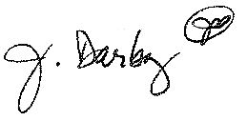
Sample Form 2 Page 1

Slide 21
Sample Form 2 Page 2

Slide 22
Form 2 (F2) Headings Required Data
1 - Date Prepared
2 - Date Sent (45 days measured from this date)
3 - Confirming Agreement (if field, phone, or email agreement was made)
4 - Estimated Construction Start
5 - Number of Pages
6 - JPA Authorization Number
    The JPA number always begins with the member’s designation.
    Follow your company’s protocol for creating the JPA number.

Slide 23
Form 2 (F2) Headings Required Data
1
2
3
4
5
6

Slide 24
Form 2 (F2) Headings Required Data

Slide 25
F2 Utility Information Section
7 - Utility Codes for owners (see section 20)
8 - Representative with phone number
9 - District-Division-Exchange
10 - Approved (per section 18.1)
11 - Taxing Instructions
12 - Accounting Data

Slide 26
F2 Utility Information Section
7
8
9
10
11
12

Slide 27
F2 Utility Information Section

Slide 28
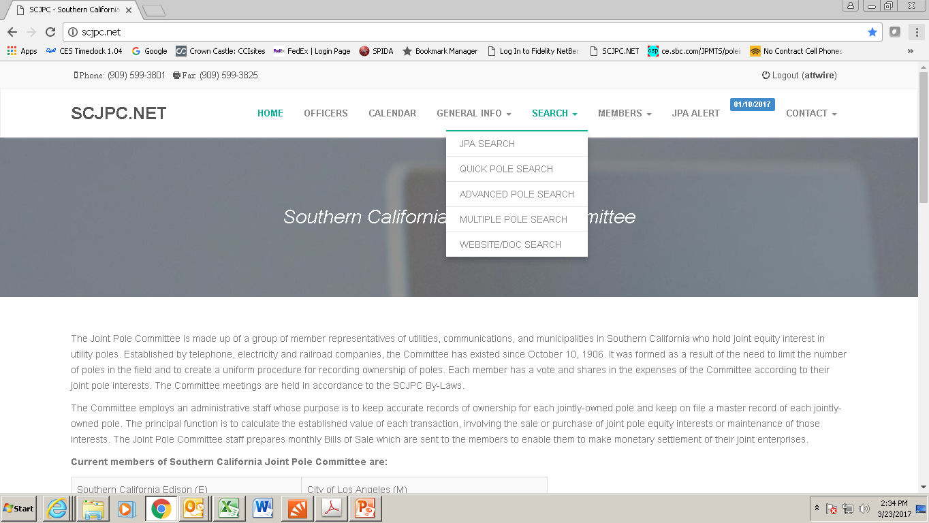
Pole Record Research
SCJPC Website: http://scjpc.net

Slide 29
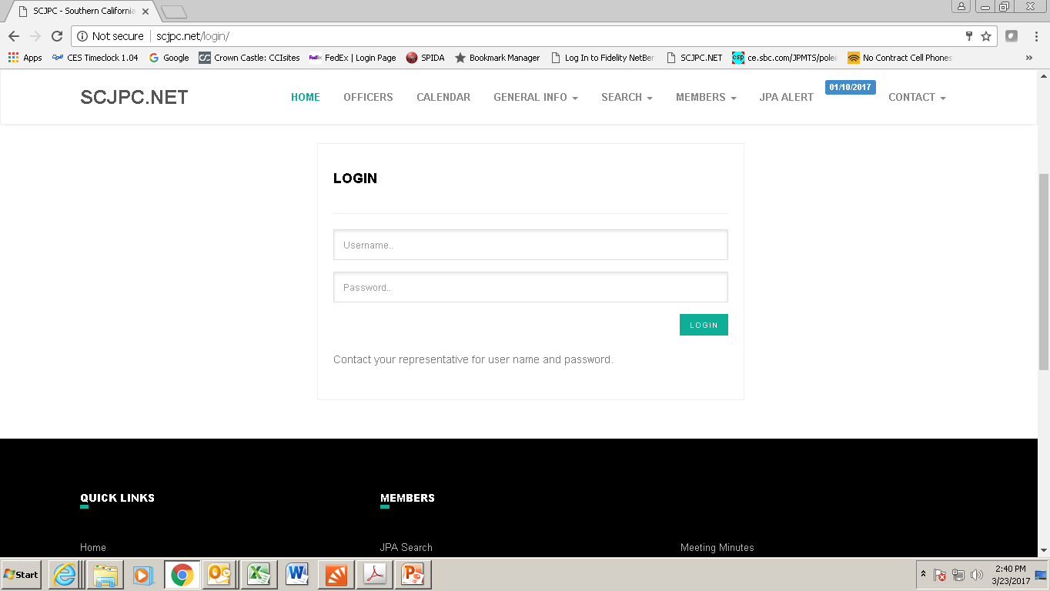
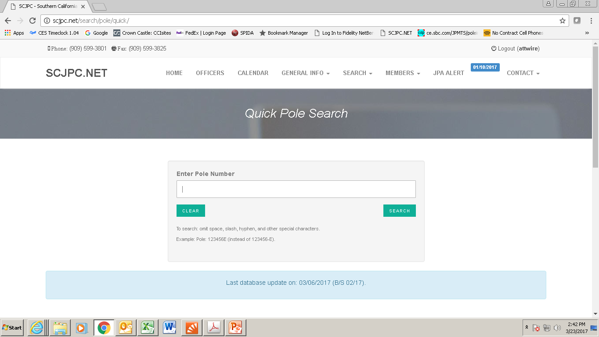
Pole Record Research
Login to access Pole Search page

Slide 30
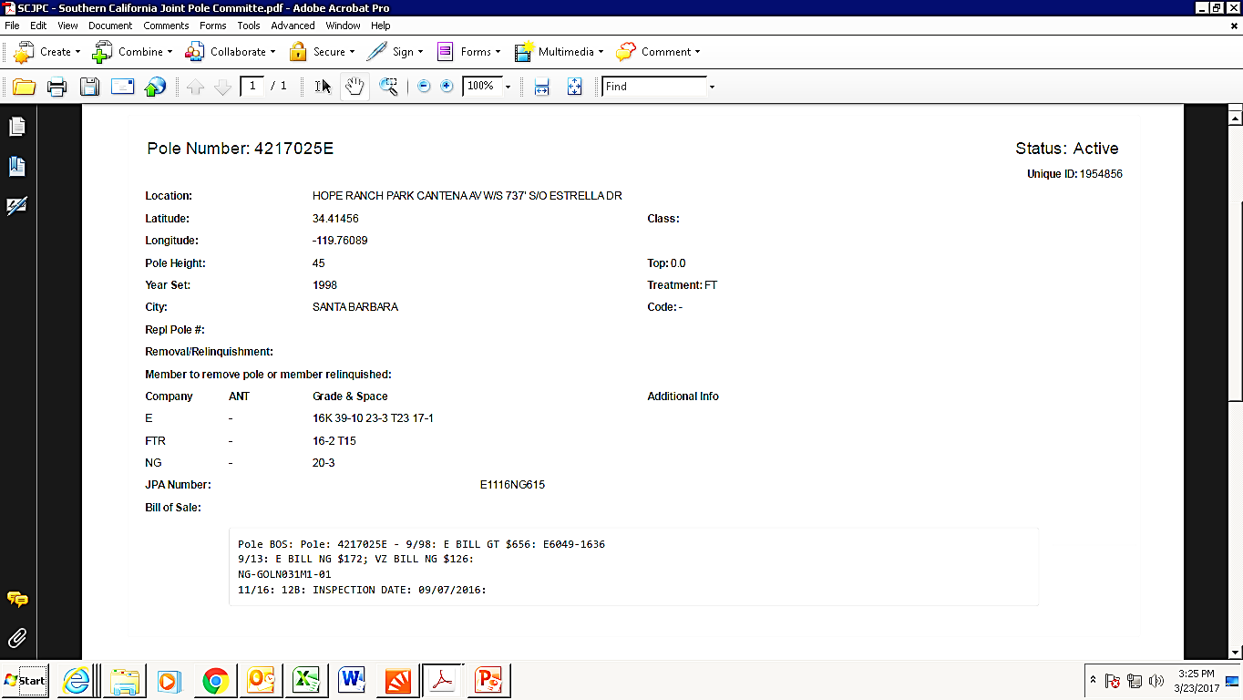
Pole Record Research

Slide 31
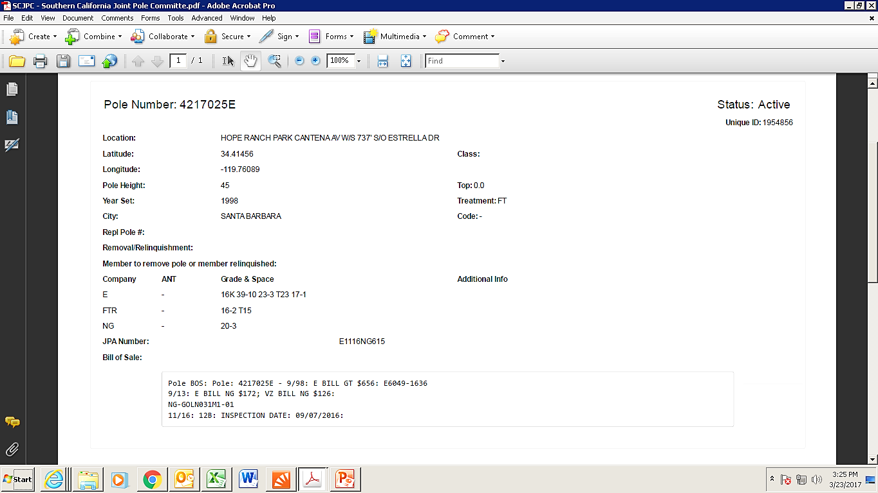
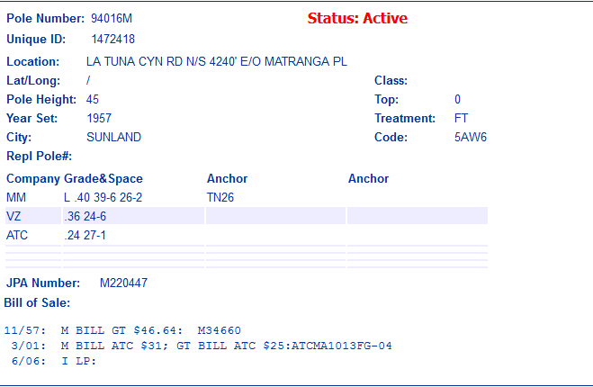
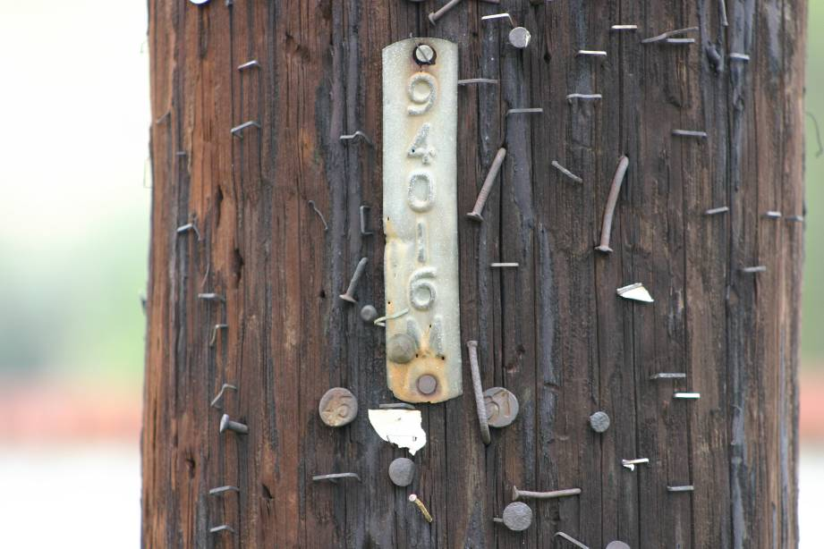
Pole Record Research

Slide 32
Unauthorized-Attachment Research
For a valid “unauthorized” JPA, the following upfront research is necessary:
If the poles on either side are jointly-owned, it is possible the pole was omitted in error from the final.
  Per discussions at JPC meetings, the members agreed not to charge 4.1 in those instances.
It is possible that a jointly-owned pole was replaced without a JPA .
  Check the JPC website for a pole at the same location or as close to the unauthorized pole.
Check for pending JPAs from the unauthorized member.
Confirm the unauthorized utility is not a tenant company
Verify that pole number is correct

Slide 33
F2 Pole Work Section
13 –Enter current owners of record per the SCJPC official record (enter owner data in the same order on every page)
14 – Current and new owners are entered in “Proposed” for each pole (enter owner data in the same order on every page)
15 - Pole No. is for existing and/or new pole numbers
16 - Pole Length/Anchor Size, Year Set, Pole Treat, Pole Class & Anchor Direction “Record” data are taken from the pole card.
17 – “Record” cells indicate how grade and space is currently configured. Circuit information needs to be applied to every pole. See section 16.3.
18 - The “Proposed” cells indicate how grade and space will be configured. Circuit information needs to be applied to every pole. See section 16.3.
19 - Item No. reflects authorized costs to be billed (see section 2.1)
20 – Location and Nature of Work
21 - Community

Slide 34
Sample Pole Card
The pole card is the next source of data used to populate the
JPA. The pole number, location, height, year set, pole treatment and community as well as the current pole owners, corresponding circuit types and grade and space are all required for the JPA.
15
20
16
21
17
13

Slide 35
F2 Pole Work Section
13
14
15
16
17
18
19
20
21

Slide 36
F2 Pole Work Section

Slide 37
F2 Pole Work Section

Slide 38
Generic Form 7

Slide 39
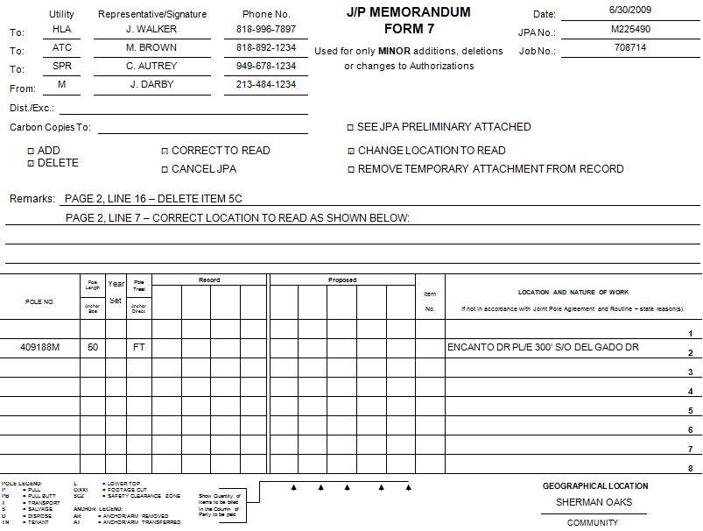
Sample Form 7

Slide 40
Form 7 Required Data
1 – Date Prepared
2 – JPA Number
3 – Job Number/Accounting Data
4 - Utility Codes for owners (see Section 20)
5 – Representative/Signature
6 – Phone Number

Slide 41
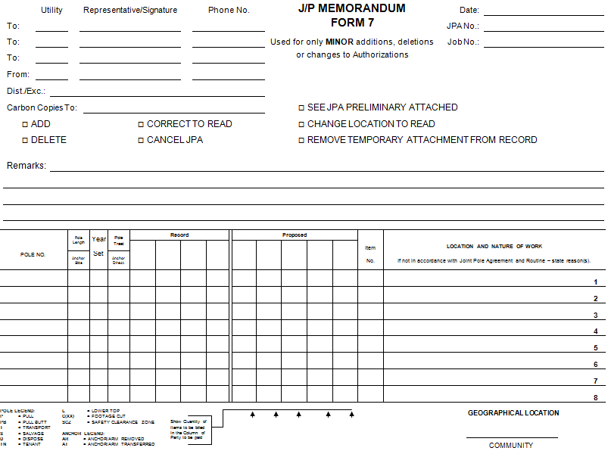
Form 7 Required Data
1
2
4
5
6
3

Slide 42
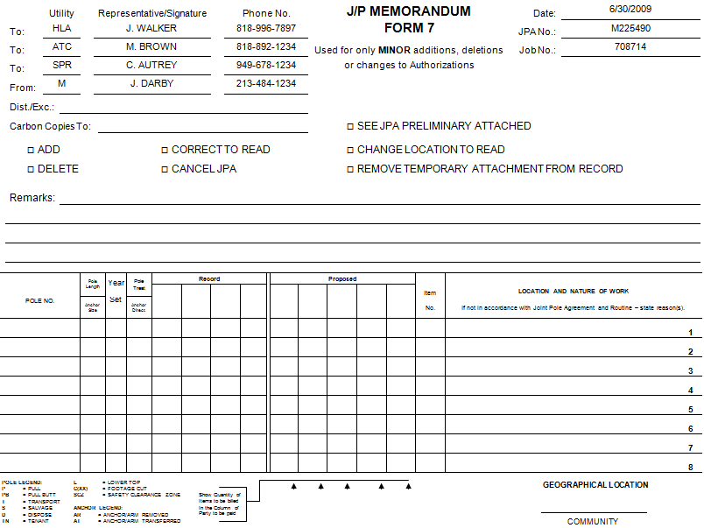
Form 7 Required Data

Slide 43
Form 7 Required Data
7 – Check appropriate box(es)
8 – Remarks: supply JPA page & line number(s) of proposed minor changes
9 – Enter changed data as required
10 - Community

Slide 44
Form 7 Required Data
7
8
9
10

Slide 45
Form 7 Required Data

Slide 46
Generic Form 9

Slide 47
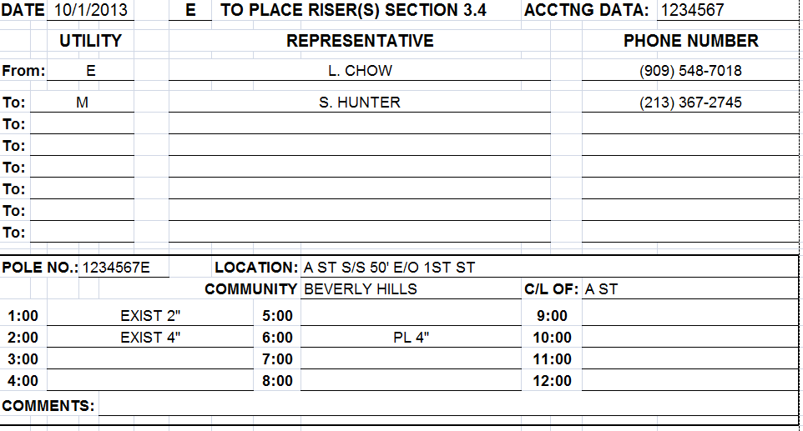
Sample J/P Riser Notification - Form 9

Slide 48
Form 9 Required Data
1 – Utility code of the member installing the riser
2 – Information of the utility sending the form
3 – Information of the other owners on record receiving the form
4 – Pole number
5 – Location
6 – Community
7 – Center Line (C/L) of the street that will be used as 12:00 for riser location reference
8 – Existing and proposed riser location and/or stand-off brackets based on the clock face (refer to riser diagram)
9 – Comments
10 – Date
11 – Accounting Information

Slide 49
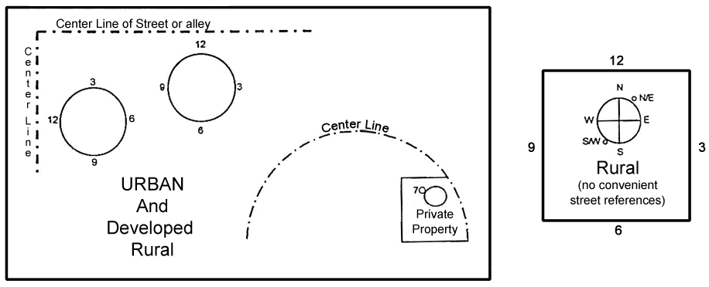
Riser Diagram

Slide 50
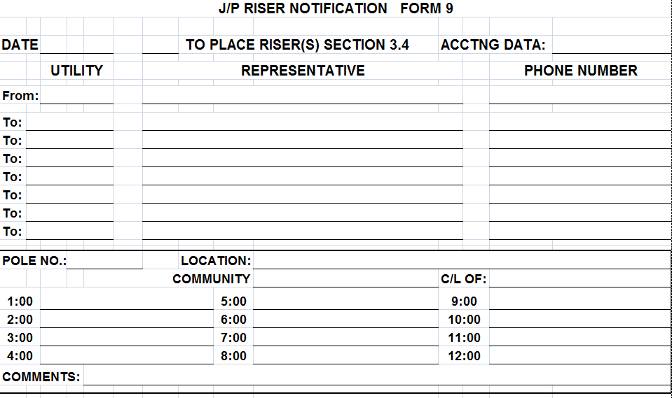
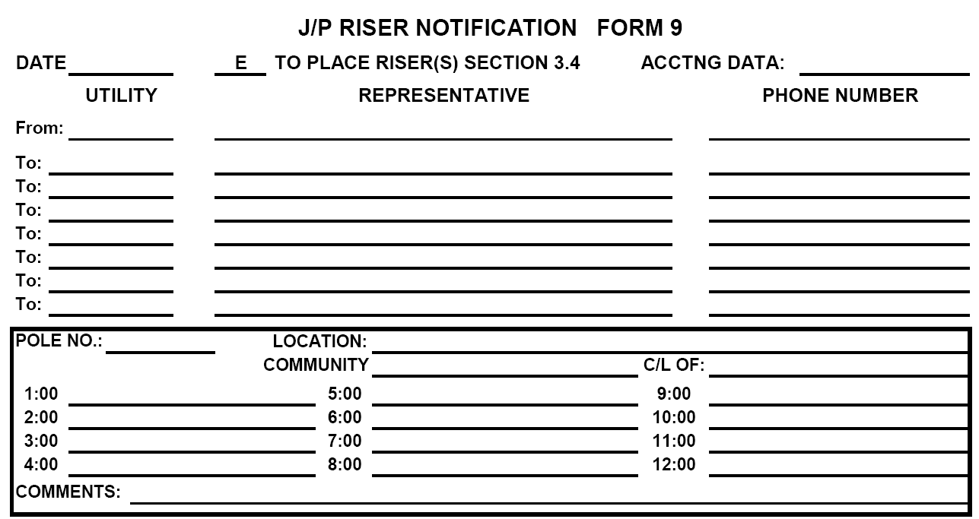
Form 9 Required Data
10
1
11
2
2
2
3
3
3
4
5
6
7
8
8
8
9

Slide 51
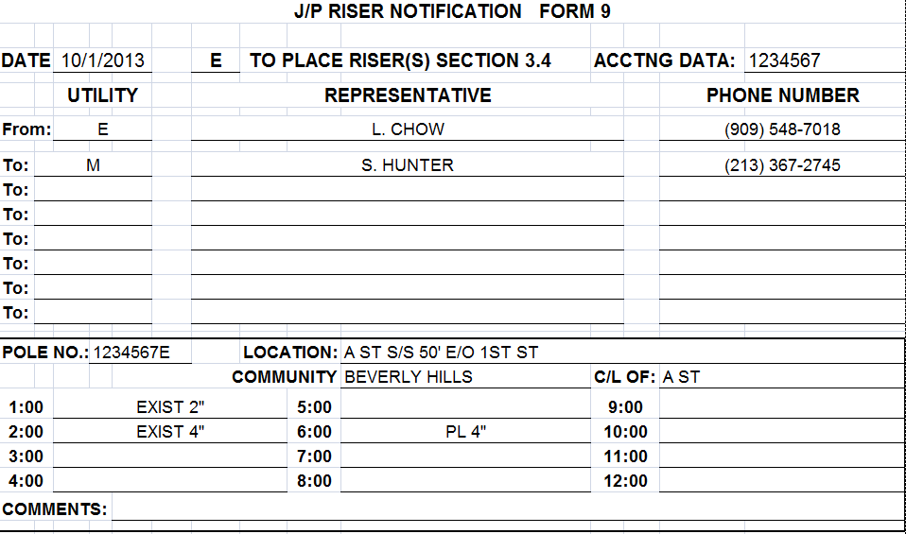
Form 9 Required Data

Slide 52
Generic Form 48

Slide 53
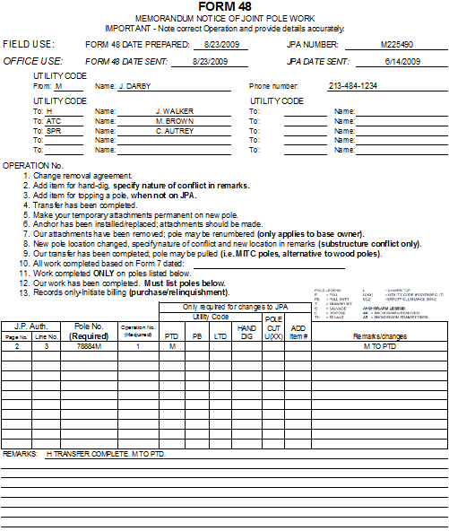
Sample Form 48

Slide 54
Form 48 Headings
Required Data
1 - Codes for other owners on JPA
NOTE: It is easier to type in all owner codes from the JPA. Highlight or circle the code of the owner to which each F48 is sent.
2 – F48 mailing date
3 – JPA Number
4 – Utility Representative

Slide 55
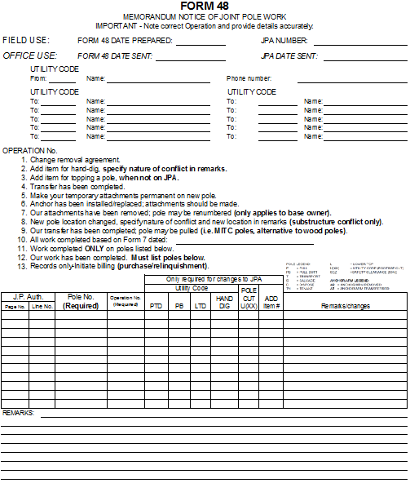
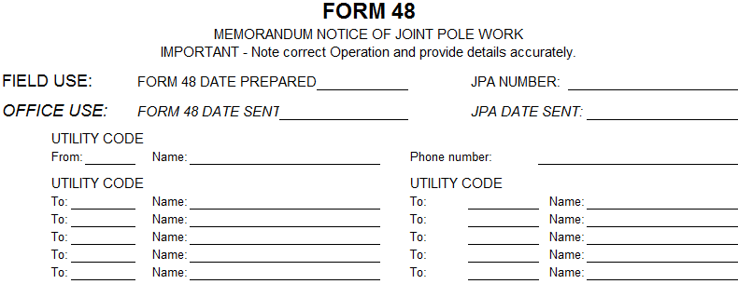
Form 48 Headings Required Data
3
2
4
1

Slide 56
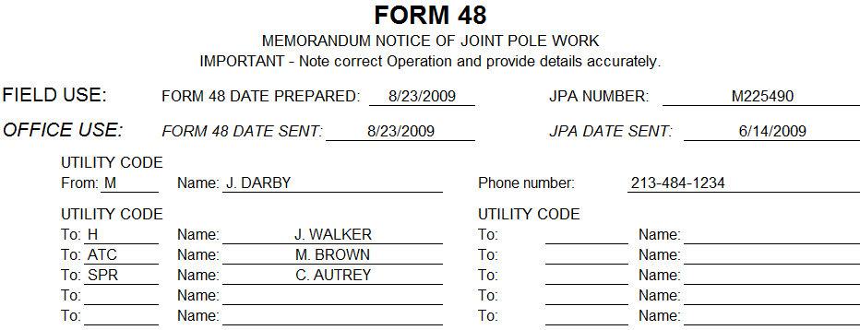
Form 48 Headings Required Data

Slide 57
Form 48 Operation Required Data
5 - The operations are clearly described. Operation 12 is most commonly used. It indicates construction was completed as indicated on the F2 and F7. Must list poles on Form 48.
6 – Operation 11 is used for partially completed work. Poles must be listed.

Slide 58
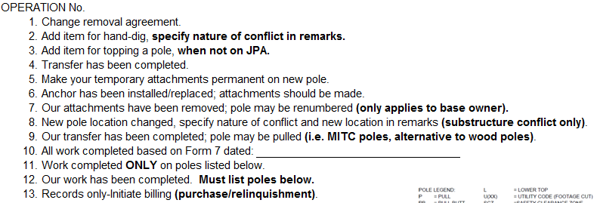
Form 48 Operation Required Data
5
6

Slide 59
Form 48 Pole Information Required Data
7 – Form 2 page number
8 – Form 2 line number
9 – Pole Number
10 – Individual operations done on that pole
11 – Remarks

Slide 60
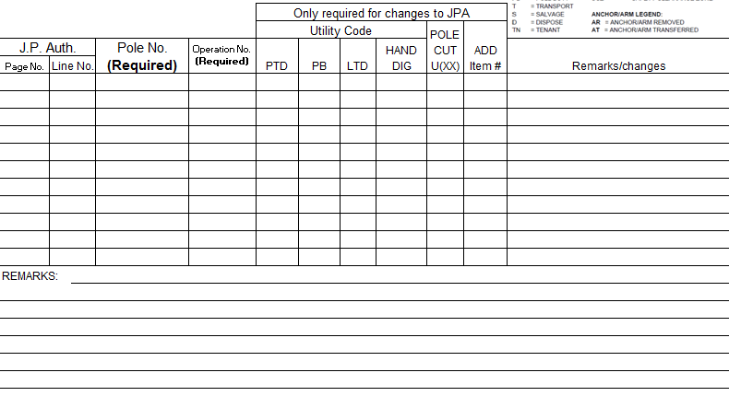
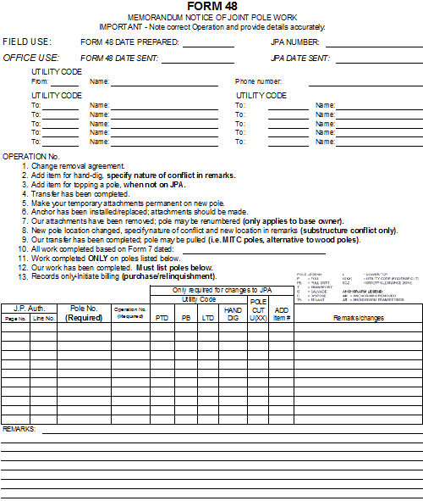
Form 48 Operation Required Data
7
8
9
10
11

Slide 61
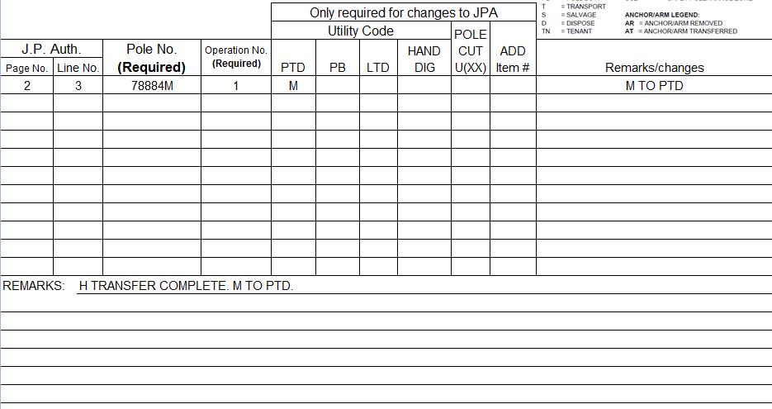
Form 48 Operation Required Data

Slide 62
Generic Form 49

Slide 63
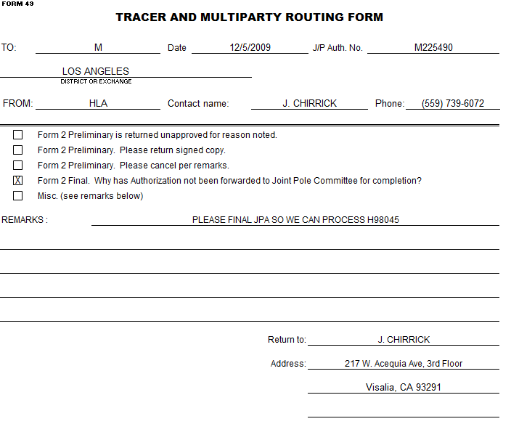
Sample Form 49
X

Slide 64
Form 49 Required Data
1 – Utility code & representative’s name
2 – Date of Form 49 sent
3 – JPA Number
4 – District or exchange
6 – Select one of the boxes
7 – Remarks
8 – From (utility name)
9 – By (name of the person issuing Form 49, legible)

Slide 65
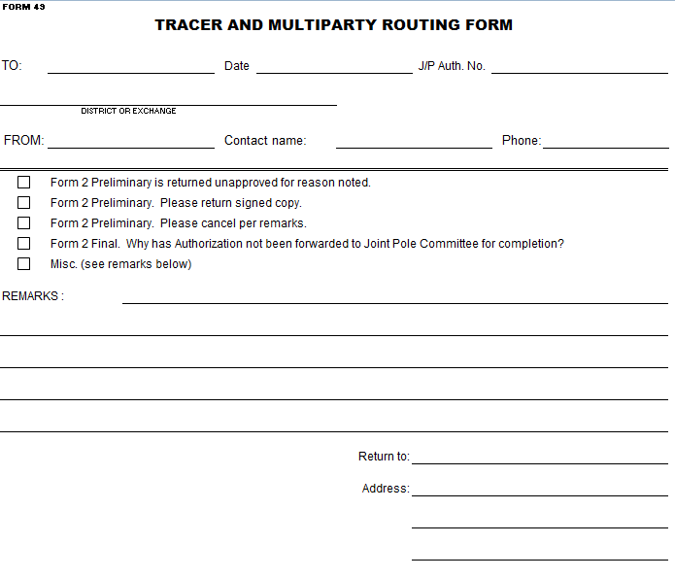
Form 49 Required Data
1
2
3
4
8
9
6
7

Slide 66
Form 49 Required Data
X
x

Slide 67
Generic Final JPA Form 2

Slide 68
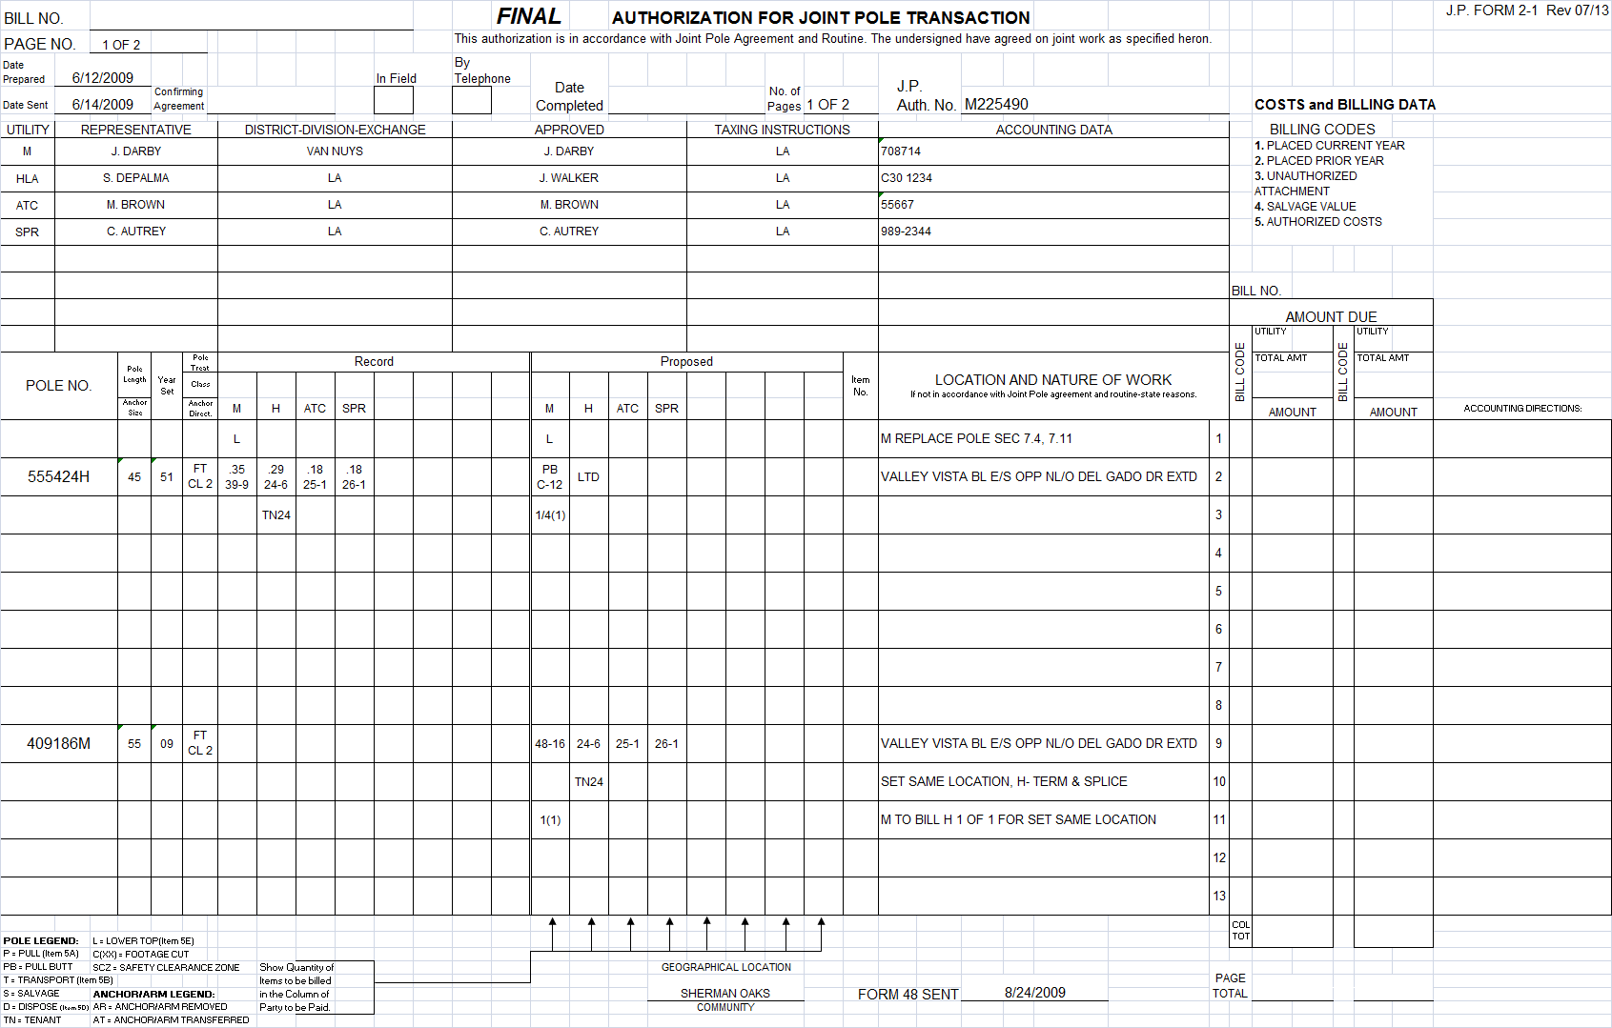
Sample Final JPA Form 2 Page 1

Slide 69
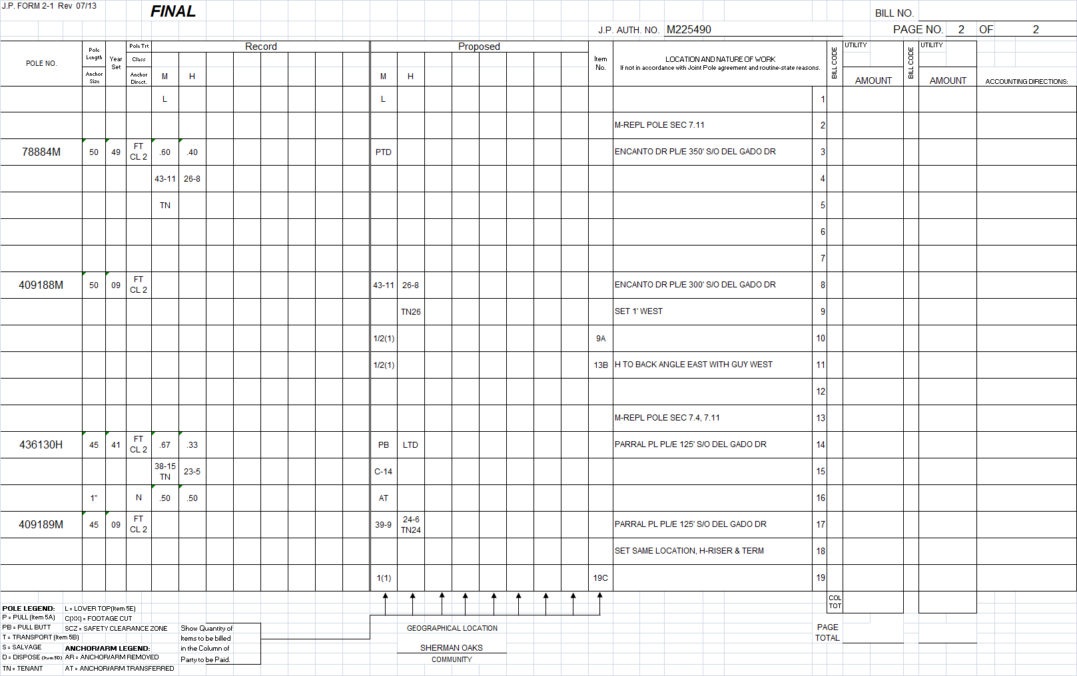
Sample Final JPA Form 2 Page 2

Slide 70
Final Form 2 (F2) Headings Required Data
1 - Date Preliminary Form 2 prepared
2 - Date sent of Preliminary Form 2
3 - Confirming Agreement (if field, phone, or email agreement was made)
4 – Date Completed (populated by SCJPC)
5 - Number of Pages
6 - JPA Authorization Number
7 – Bill Number (populated by SCJPC)
8 – Page Number
9 – Form 48 Date Sent

Slide 71
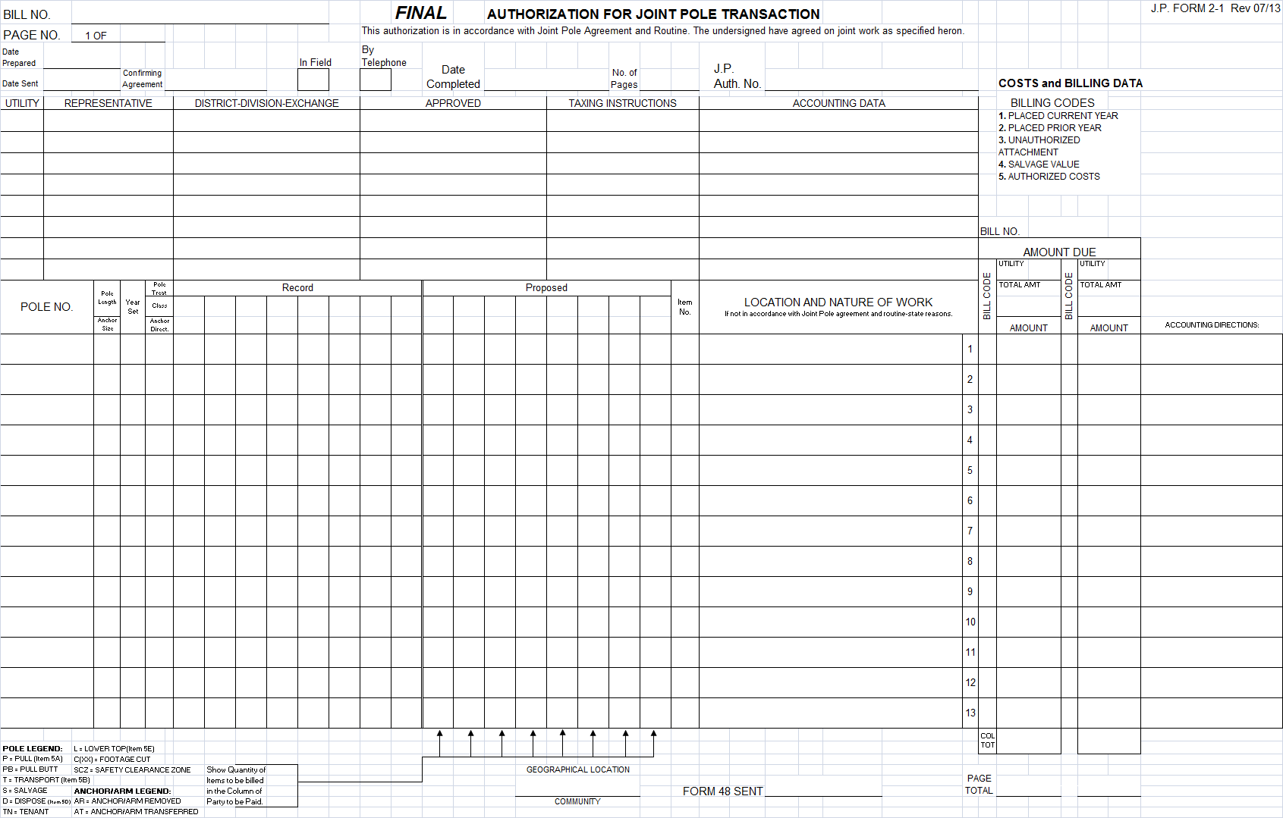
Final Form 2 (F2) Headings Required Data
7
1
8
2
3
4
5
6
9

Slide 72
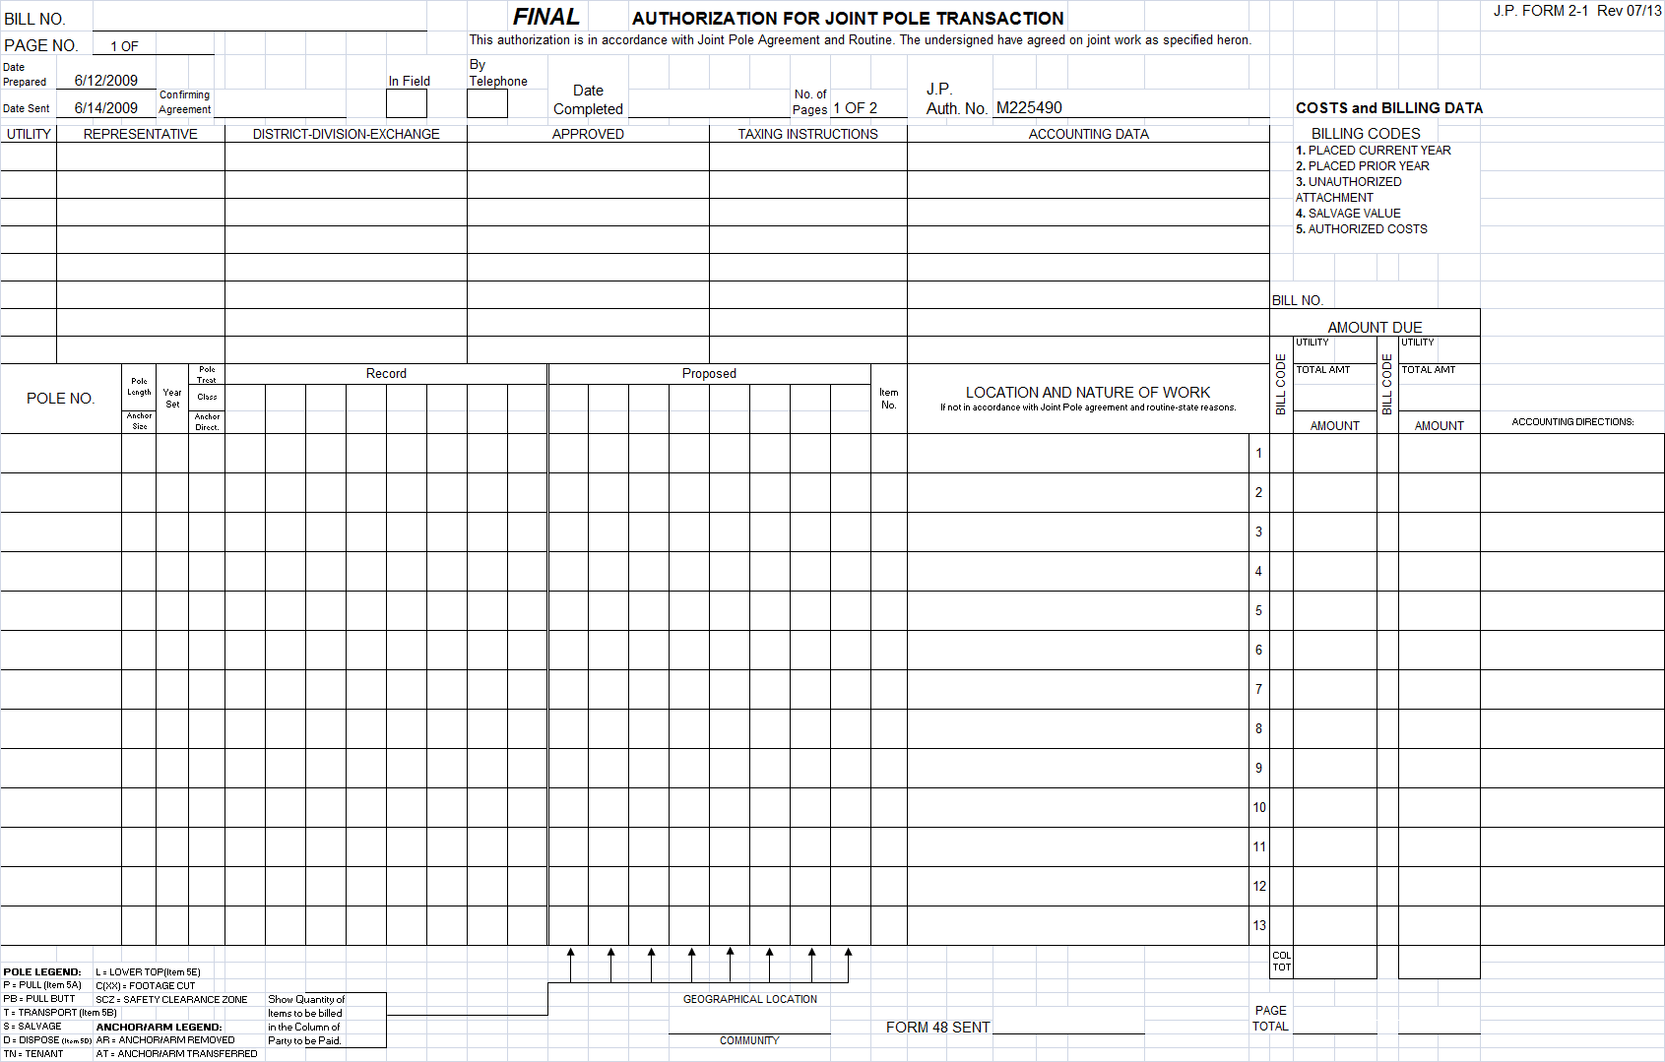
Final Form 2 (F2) Headings Required Data

Slide 73
Final F2 Utility Information Section
9 - Utility Codes for owners (see section 20)
10 - Representative
11 - District-Division-Exchange
12 - Approved from the Preliminary Form 2
13 - Taxing Instructions
14 - Accounting Data

Slide 74
Final F2 Utility Information Section
9
10
11
12
13
14

Slide 75
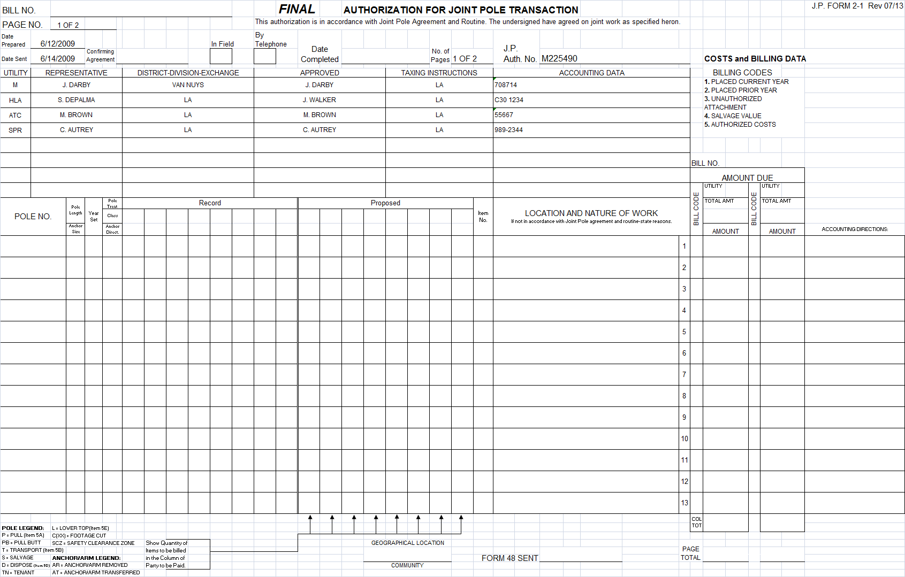
F2 Utility Information Section

Slide 76
F2 Pole Work Section
15 –Enter current owners of record per the SCJPC official record (enter owner data in the same order on every page)
16 – Current and new owners are entered in “Proposed” for each pole (enter owner data in the same order on every page)
17 - Pole No. is for existing and/or new pole numbers
18 - Pole Length/Anchor Size, Year Set, Pole Treat, Pole Class & Anchor Direction “Record” data are taken from the pole card.
19 – “Record” cells indicate how grade and space is currently configured. Circuit information needs to be applied to every pole. See section 16.3.
20 - The “Proposed” cells indicate how grade and space will be configured. Circuit information needs to be applied to every pole. See section 16.3.
21 - Item No. reflects authorized costs to be billed (see section 2.1)
22 – Location and Nature of Work
23 – Community
24 – To be filled out by SCJPC staff

Slide 77
F2 Pole Work Section
24
24
15
16
17
18
19
20
21
22
24
23

Slide 78
F2 Pole Work Section Page 1

Slide 79
F2 Pole Work Section Page 2

Slide 80
Sample Photocopy of Finalized Form 2 JPA
Provided by SCJPC Office

Slide 81
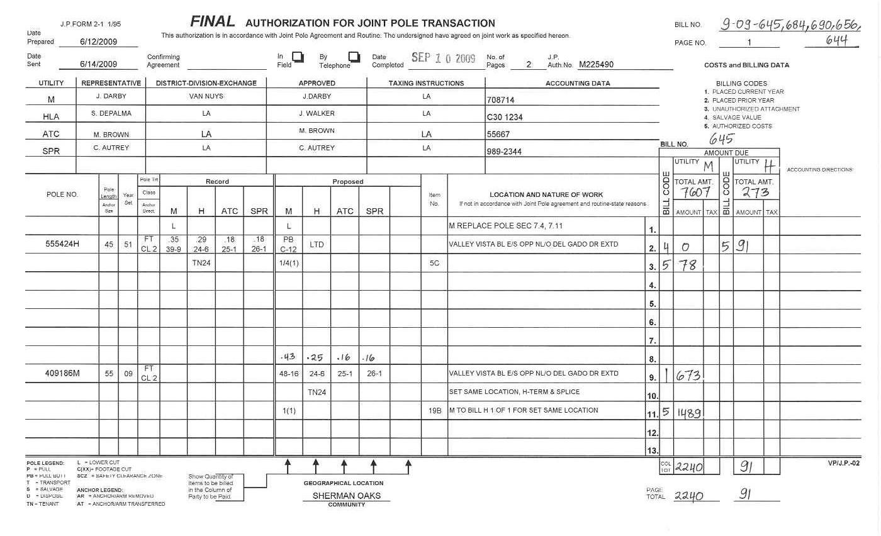
Finalized Form 2 JPA
Page 1

Slide 82
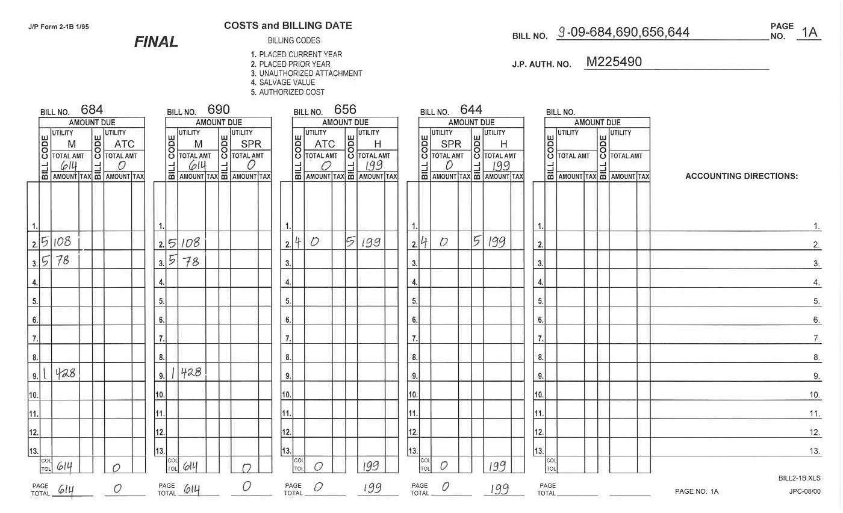
Finalized Form 2 JPA
Page 1A

Slide 83
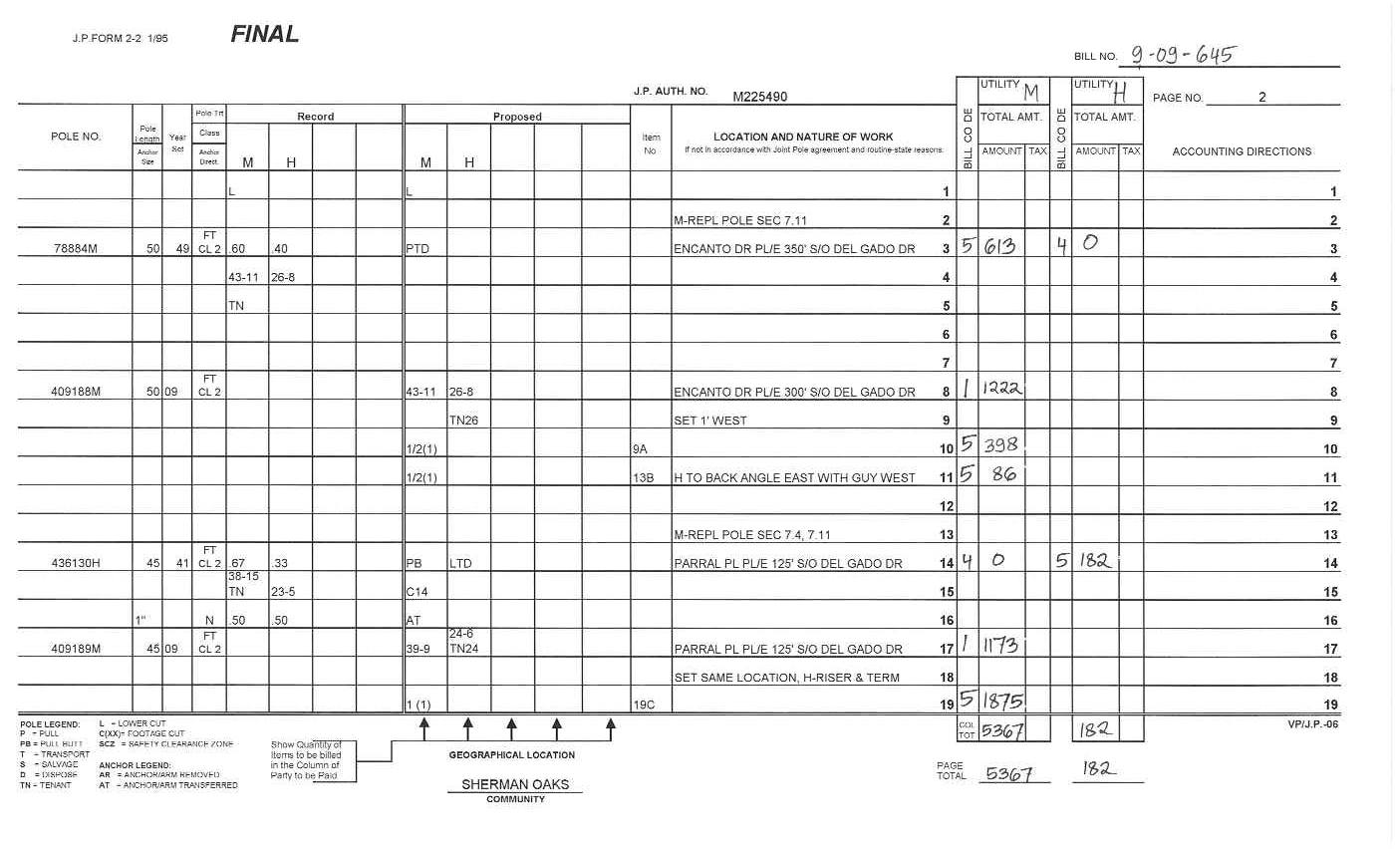
Finalized Form 2 JPA
Page 2

Slide 84
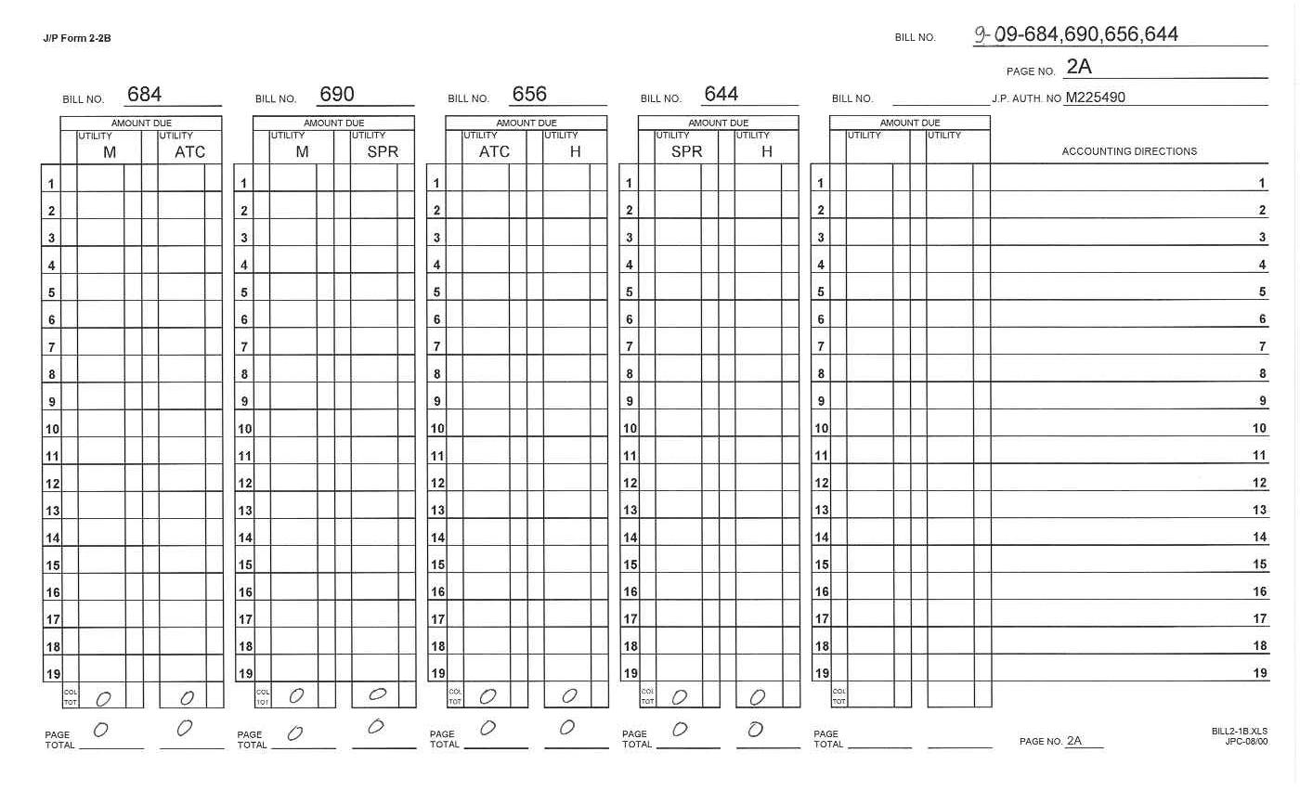
Finalized Form 2 JPA
Page 2A

Slide 85
Generic Bill of Sale – Form 44

Slide 86
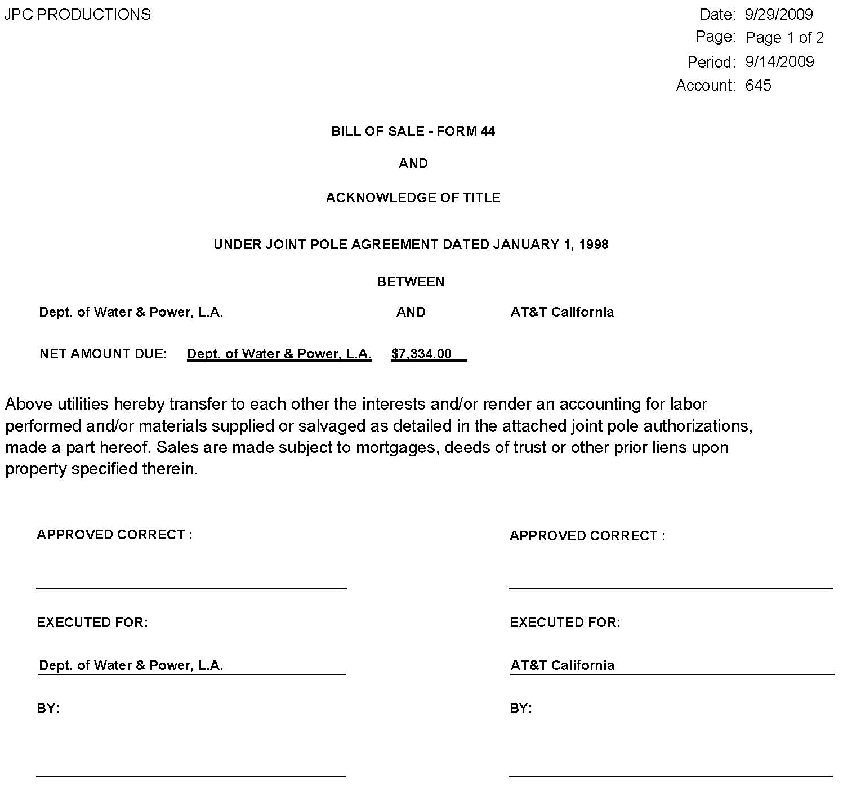
Bill of Sale – Form 44

Slide 87
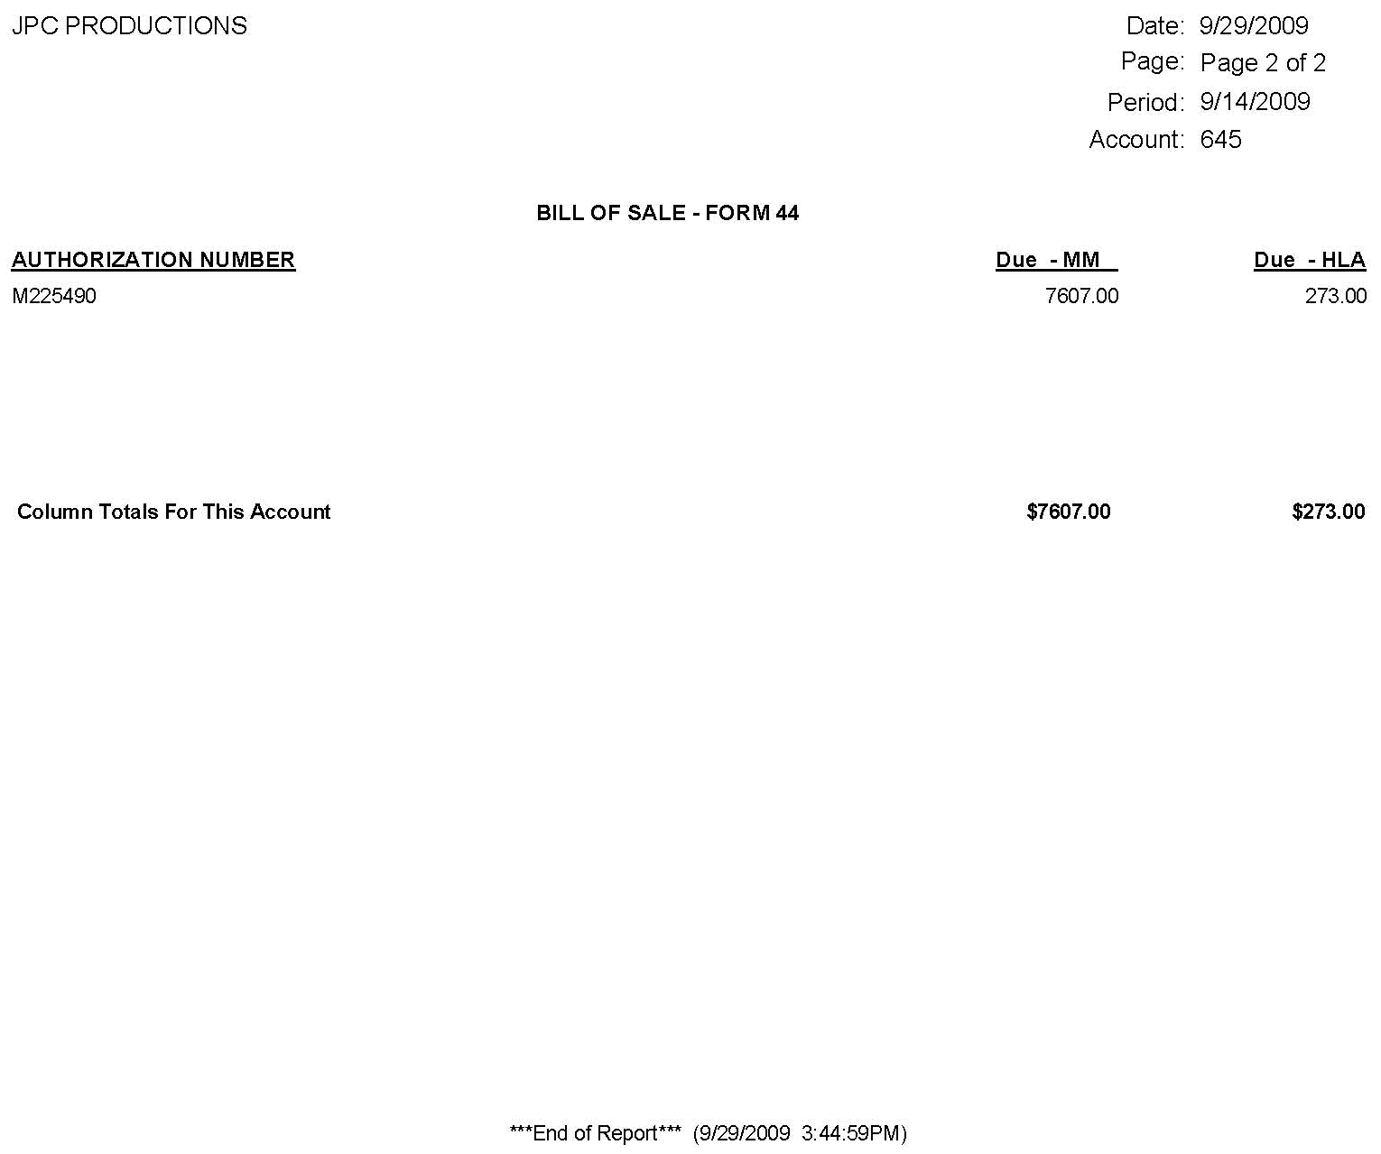
Bill of Sale – Form 44

Slide 88
Bill of Sale – Form 44
Utilities will receive this form from the SCJPC office reflecting monthly activity
This form is authorization for each utility to invoice for the monthly activity

Slide 89

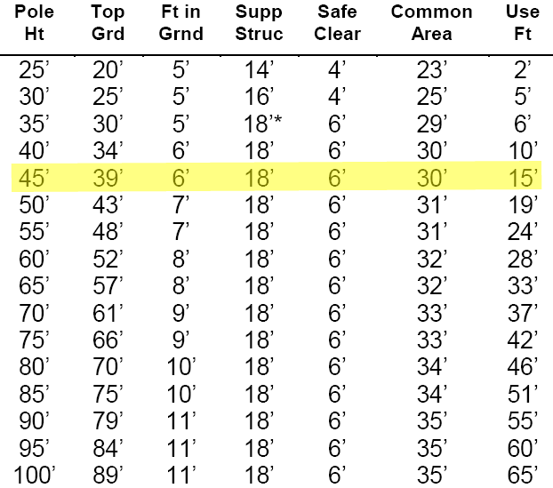
Space Allocation
Space shown for each utility on JPA must equal usable footage. See section 16. For allocation purposes, safety clearance zone for a 45’ pole is from the highest communication up 6’. Any remaining usable footage is allocated to the base owner. As new members purchase space on the pole, the safety clearance zone moves up no higher than 6’ below the lowest power.
39’ Grade
39’ Grade
Power Space [11’]
Power Space [9’]
28’ Grade
30’ Grade
Safety Clearance Zone [6’]
Safety Clearance Zone [6’]
22’ Grade
24’ Grade
45’ POLE
Communication Space [4’]
45’ POLE
Communication Space [6’]
18’ Grade
Total Usable Footage = 15’
Total Common Area (Non-Usable Footage) = 30’
Power Space & Grade = 39-11
Comm. Space & Grade = 22-4
18’ Grade
Total Usable Footage = 15’
Total Common Area (Non-Usable Footage) = 30’
Power Space & Grade = 39-9
Comm. Space & Grade = 24-6
Support Structure [18’]
Support Structure [18’]
Footage in Ground [6’]
Footage in Ground [6’]

Slide 90
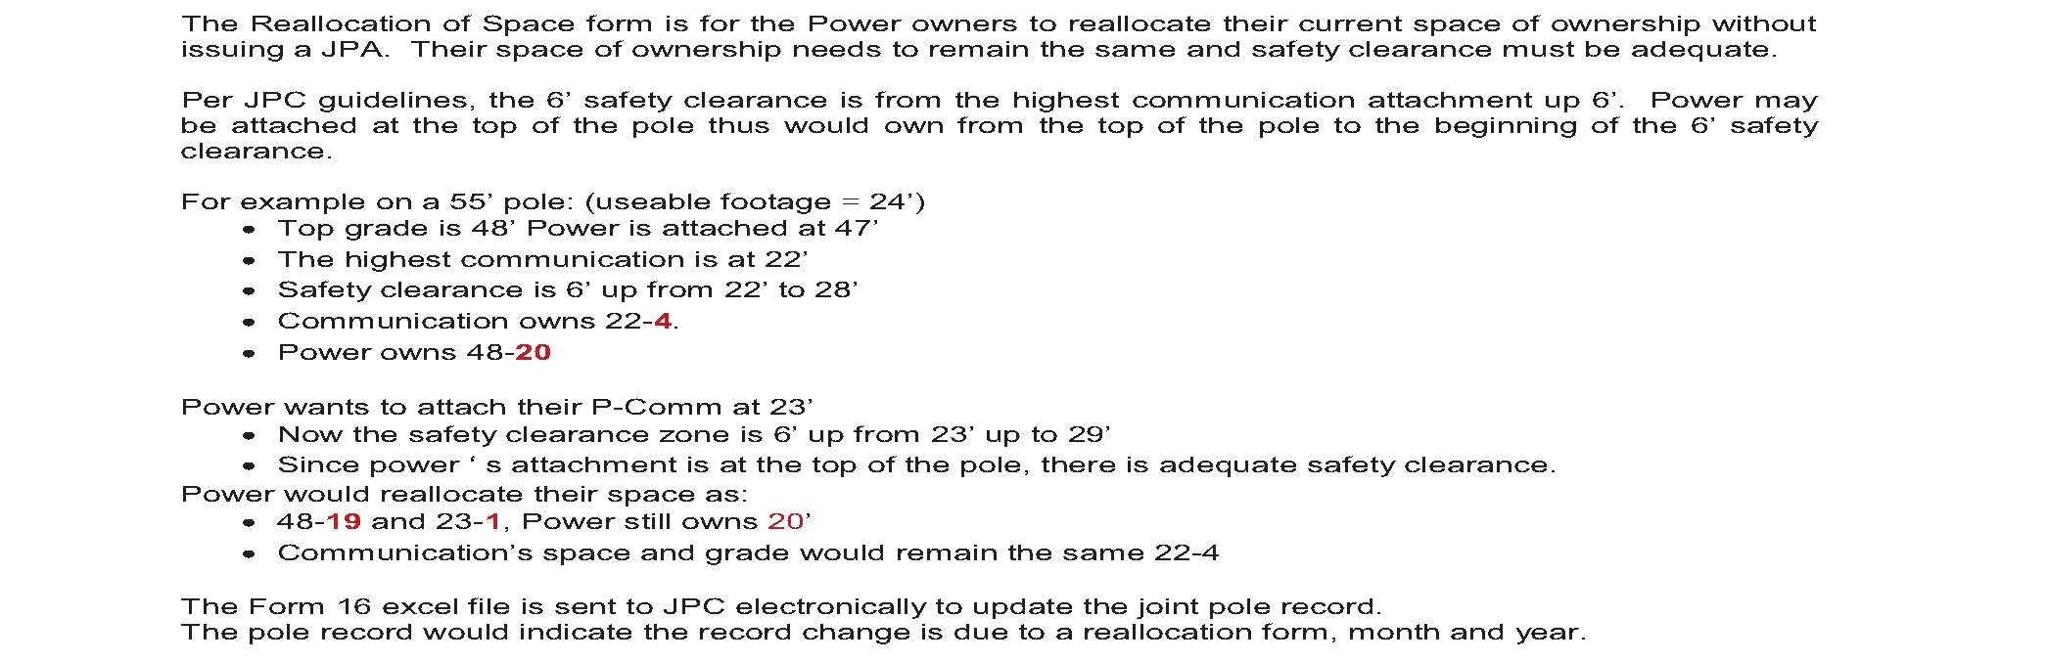
Reallocation of Space - Form 16

Slide 91
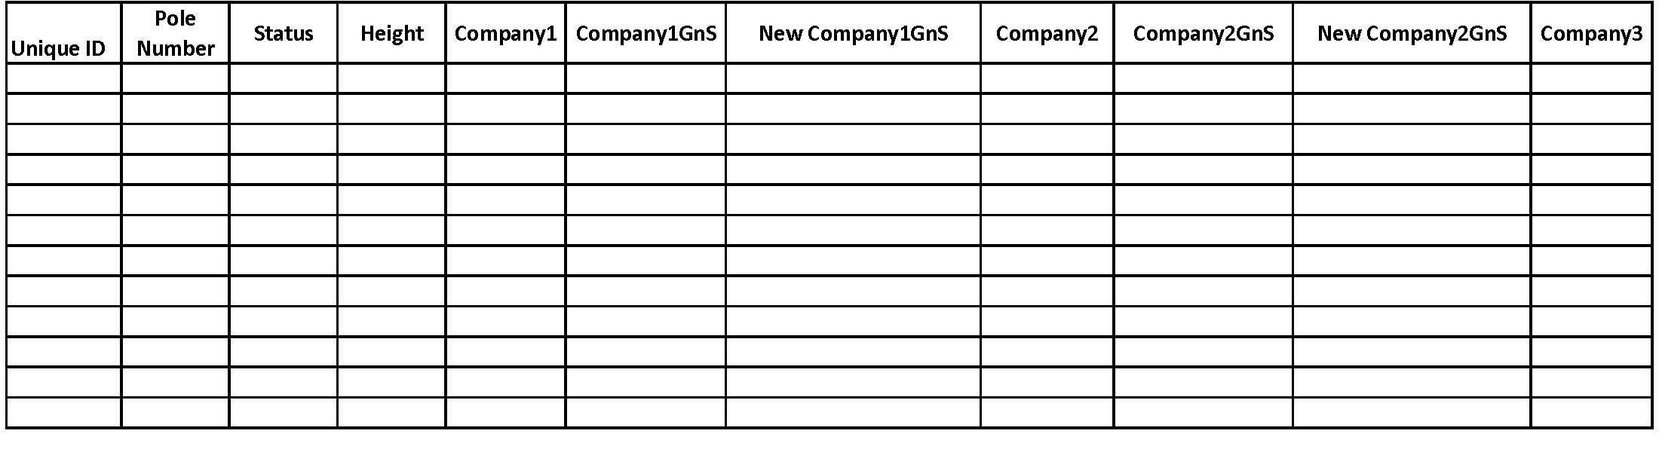
1
2
1
2
This information can be found on the SCJPC pole record. Status of pole record must be active (A)
The new space and grade for each owner, ultimately how the record will be updated.

Slide 92
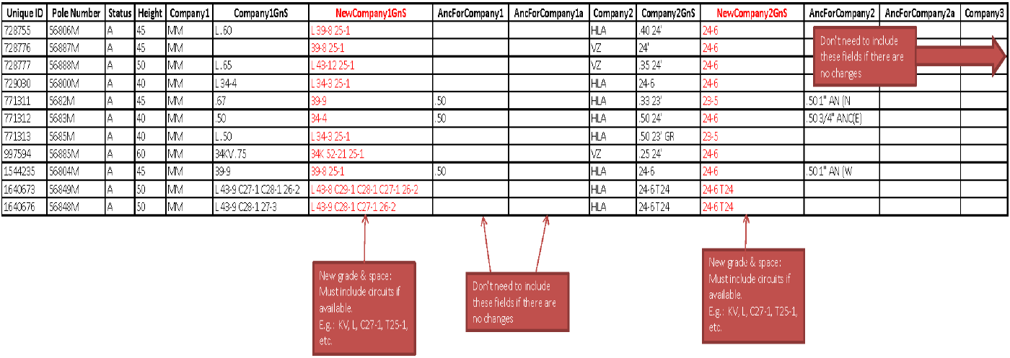
Example of Completed Form 16

