Slide 1
Basic JPA Training
Revised 201812
For Confidential Use and Distribution
Content: Earle Carrion
Notes:
Presenter Note:
Please have copies of the SCJPC Routine Handbook and Commonly Used Sections/Items available for reference during presentation.

Slide 2
History
Joint Pole Committee
Formed on October 10, 1906 by the Telephone, Electric, and Railroad companies, the Southern California Joint Pole Committee (SCJPC) was created with the following intentions:
To limit the number of utility poles in the field
To create a uniform procedure of recording joint ownership
Today, the Committee is comprised of over 30 members.
A full list of committee members and representative contacts can be found here: http://scjpc.net/members/member-contact-information/

Slide 3


Purpose
SCJPC (staff)
Maintain a master record of jointly-owned poles
Process the sales/purchases transactions involving existing jointly-owned poles, and solely-owned poles intended for joint use*
This allows members of the SCJPC to become legal joint owners on Communication and Distribution poles, through regulated prices of ownership and shared maintenance costs.

Slide 4
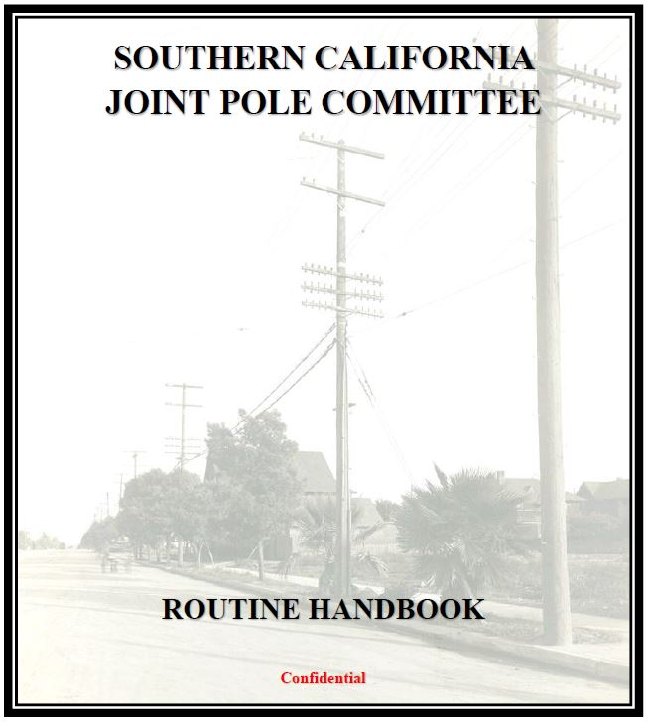
Method of Joint-Ownership
SCJPC Routine Handbook
Guide to processes and procedures for Joint Pole Authorizations
Intended that all members participate under
the same rules established therein
Revisions published every calendar year
Available at SCJPC.net

Slide 5
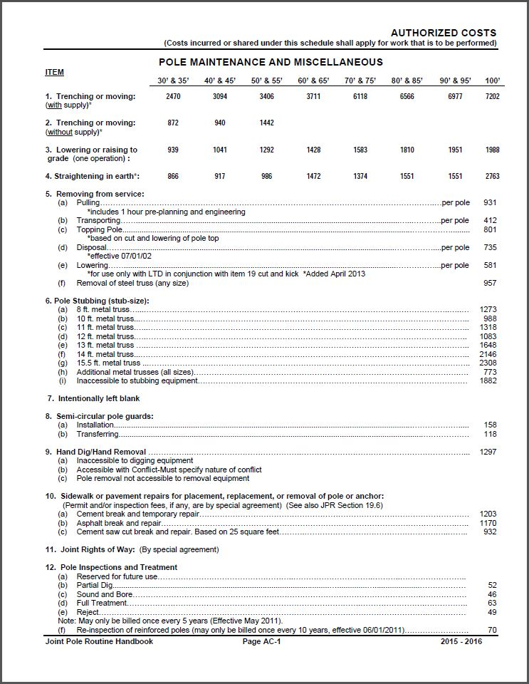
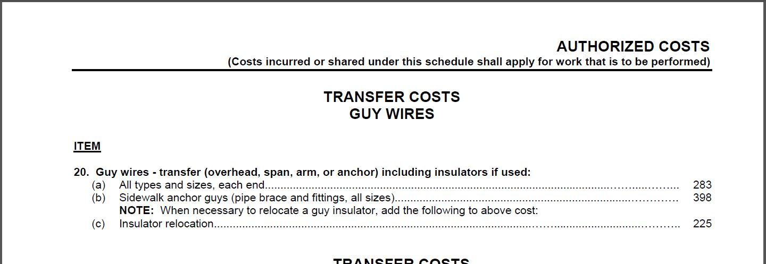
Method for Cost Recovery
Authorized Costs
Categorized by Type of Work, and then by Item Numbers and its Associated Cost
Available at SCJPC.net

Slide 6

Committee Meetings
SCJPC Ad-Hoc & Administrative Board Meetings
Two days every month
Discussions on current procedures / proposals for new procedures
Amendments to the SCJPC Routine Handbook
Calculate adjustments to Authorized Costs and Pole Prices
Issue JPA-Alerts

Slide 7
Joint Pole Authorization
When is a JPA Required?
Member Utility is not on record, and is making a new attachment
Member Utility is on record, and a new attachment requires more space than currently owned
Member Utility is on record, and the only work is to place a new anchor
A Member Utility engages in work that causes a pole to fail its structural analysis
A new pole is being placed for immediate use within a joint-use area
A Member Utility’s existing attachment is not on record, and no pending application exists for said attachment
A Member Utility engages in actions that incur shared costs
A change to the existing record is required, e.g. rearrangement or a correction to the record

Slide 8
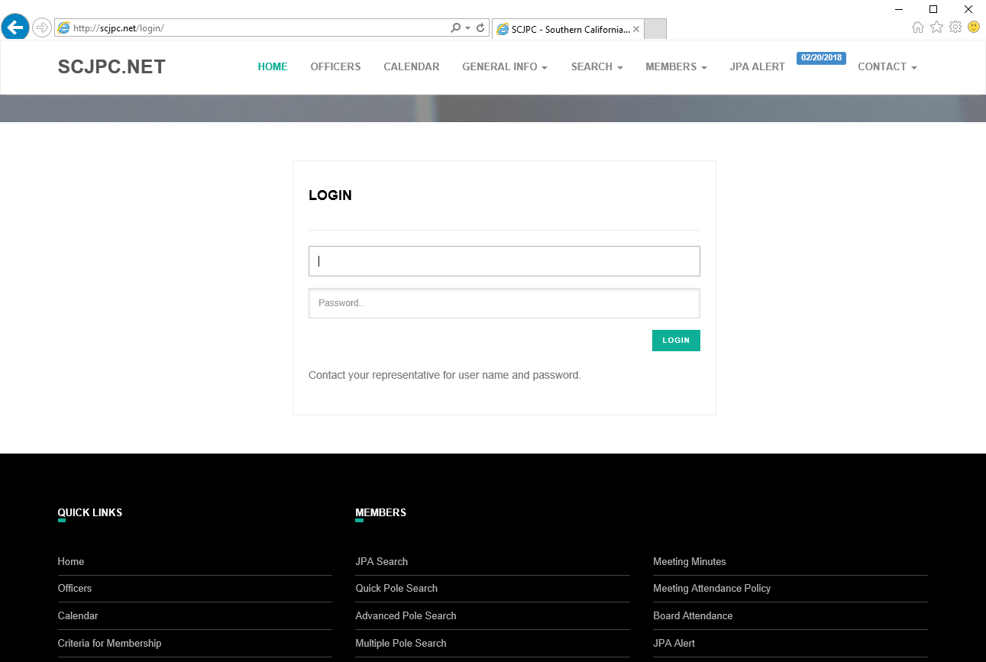
Record of Ownership
http://SCJPC.net
STEP 1
STEP 2
Contact your JPC representative for login information

Slide 9
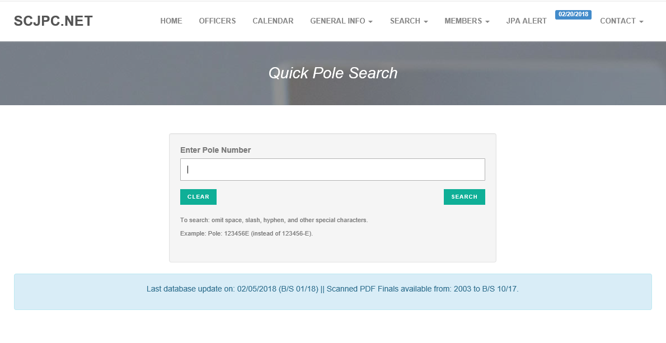
Record of Ownership
STEP 3
Only poles that are jointly owned will yield results of active records.

Slide 10
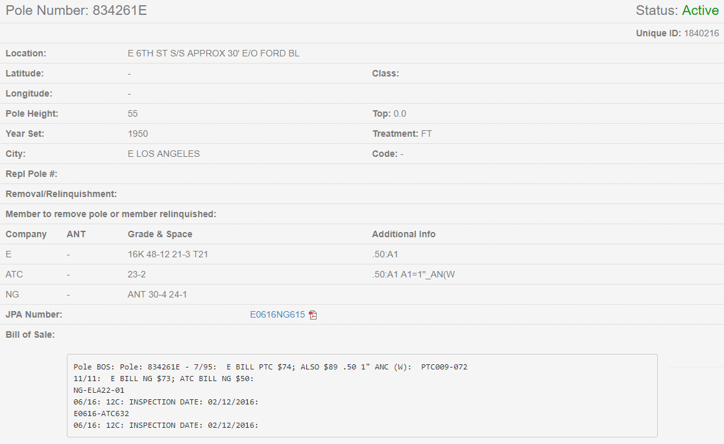
Record of Ownership
Pole Card
Pole Information
Existing authorized owners
Space of Ownership (Grade & Space)
Additional Info of Joint Facilities
Bill of Sale History
1
2
3
4
5
Notes:
Presenter Script:
There are five main parts to a pole record (pole card).

Slide 11
Basic JPA Flow Chart
Major
START
Preliminary Form 2 package issued. Members have 45 days to review / redline / respond.
Changes
Form 7 issued.
Members have 15 days to respond.
Minor
None
45 day time period expires and/or JPA not contested,
JPA valid for Construction.
Form 7 issued.
Members have 15 days to respond.
Changes
Minor
None
Work completed, Form 48 Issued, (other members can perform their work as applicable)
Form 2 FINAL issued to Joint Pole Committee
Form 44 Issued by JPC for all members, Bill of Sale amounts calculated by JPC, individual members invoice for transactions

Slide 12
Grade & Space
What is GR&SP?
Format indicating the Owned Space of a JPC Member
Two numbers: Height (where ownership begins) - Owned length (of space below)
Reflects occupied space of attachment(s) (at least)
Minimum ownership = 1ft.
Maximum ownership = Entire pole (100% or solely-owned)
Excludes Safety Clearance Zone (SCZ)* (Max. 6ft.)
Excludes Support Structure* (Max. 18ft.)
Exact ft. attachment = Requires purchase of 1ft below (comm attachment)
  E.g. A single comm attachment at 20’0” = GR&SP of 20-1

Slide 13
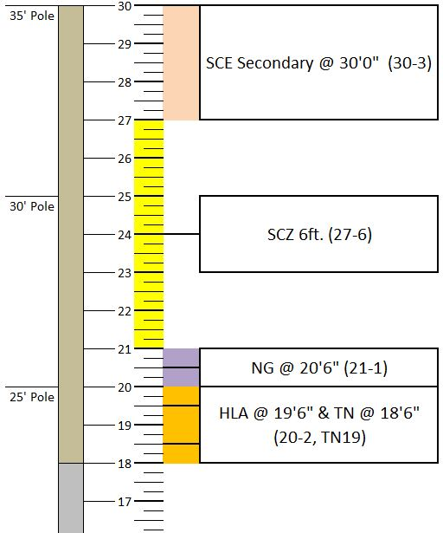
Grade & Space
What is GR&SP?
Example of assigned GR&SP per
attachments on a 35ft. Pole
E = 30-3
NG = 21-1
HLA = 20-2, TN19
SCZ = 27-6 (not reflected on Pole Card)
Notes:
Presenter Note:
**Point out that SCZ can be less than what is physically present, due to the rules of calculating GR&SP. Routine Handbook Example 27.**
Presenter Script:
In this example, SCE GR&SP would need to be 30-4 if secondary was at 26’5””. This will seem to show only 5ft of SCZ (26-5), but is actually correct, since the 6ft of physical separation is present.

Slide 14
GO95 Compliance
Basic GO95 Guidelines
Minimum 12in. between unassociated comm(s) (vertically)
  Exceptions with use of arm/guard arm – 3in. (horizontally)
Minimum 6in. between associated comm(s) (vertically)
6ft. between Secondary Power and nearest comm line(s) below
  May be reduced with an arm/guard arm – no less than 4ft.
10ft. between Primary Power and nearest comm line(s) below
  Clearance may not be reduced
Notes:
Presenter Note:
**Point out that GO95 clearances refer to physical measured separations, which may differ slightly from calculated GR&SP** (as noted in previous slide).

Slide 15
GO95 Compliance
Basic GO95 Guidelines / Pole-Mounted Antennas
Minimum 2ft. between pole-mounted antenna and unassociated comm
  May be reduced with associated comm line(s) – no less than 10in.
Minimum 6ft. Between Secondary to pole-mounted antenna
  May not be reduced
Minimum 12ft. Between Primary to pole-mounted antenna
  Only if Secondary is not present
Minimum 2ft between (power-owned) guy to pole-mounted antenna
  If guy is positioned between lowest power and antenna
Antenna clearances are taken from antenna extremities, cable drip loops, including any portion of the supporting structure that physically attaches the antenna to the pole.
Notes:
Presenter Note:
**Point out (again) that GO95 clearances refer to physical measured separations, which may differ slightly from calculated GR&SP**

Slide 16
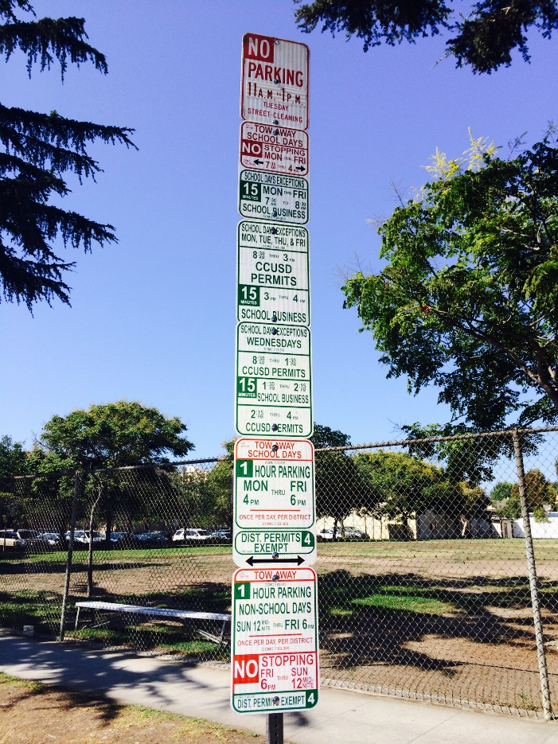
Authorization Comprehension
Language and Interpretation
Scope of Work (SOW) cited via Section Numbers
  As dictated within Routine Handbook
    Billable
    Non-billable
Item Numbers
  As dictated within Authorized Costs
    Used for calculating shared costs only
JPA Abbreviations
  For generally accepted abbreviations, please refer to Section 20.3-4 in Routine Handbook

Slide 17
JPA Forms Overview

Slide 18
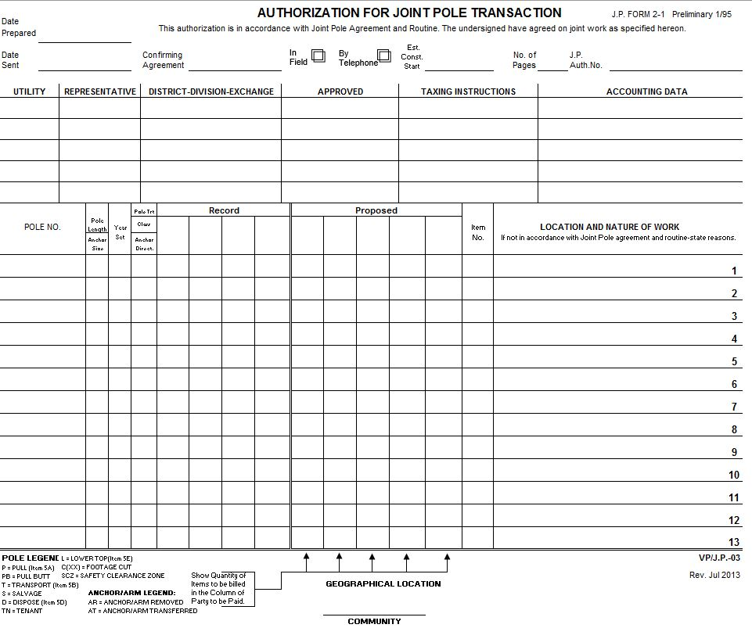
Preliminary Form 2
Form 2 Overview
Poles listed linearly – with pole number, characteristics, and location on same line
Outlines Purchase/Sale of Interest/SOW
  Section Numbers
Lists any Shared Costs
  Authorized Costs (Item numbers)
Must not contradict GO95
  Clarify with notes if required
45-day time limit – from Date Sent

Slide 19
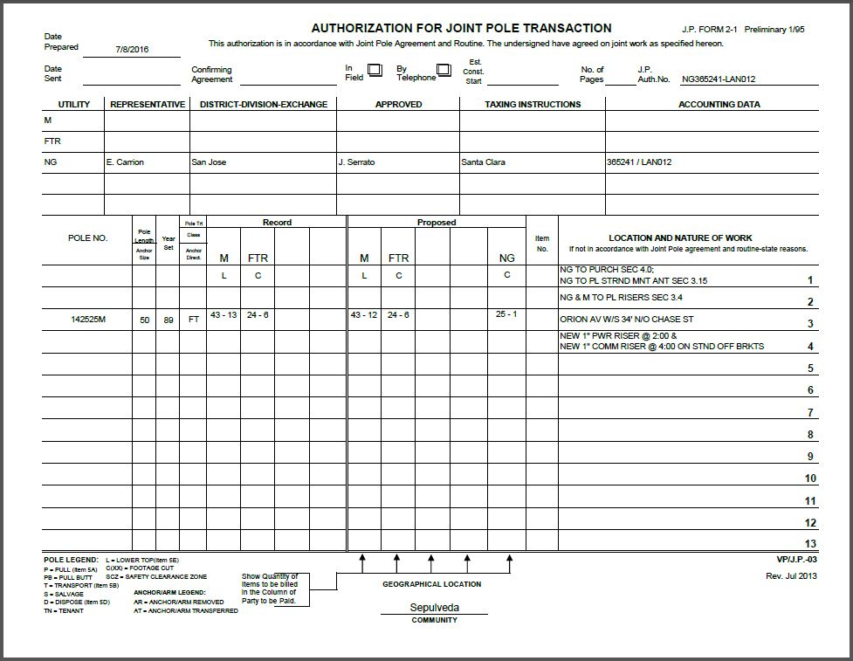
Preliminary Form 2
Form 2 Basics
Header
Record – Pole Card
Proposed
Nature of Work – details of Shared Costs, and Misc. Information
1
2
3
4
Notes:
Presenter Script:
There are four main parts to a Form 2.
Record information (Part 2) is primarily taken directly from the Pole Card, exactly as represented, with exception to cases in which a pole is solely-owned, the record is incorrect, or an unauthorized attachment is involved.

Slide 20
Preliminary Form 2
Form 2
Required Information
Date Prepared/Sent
JPA Number
Header
Community
1
2
3
4
Notes:
Presenter Script:
Header:
The initiating member is only responsible for ensuring all relevant members are cited within the header (under the “Utility” field).
It is then the responsibility of those receiving members to complete their own designated information fields, upon review of the JPA.
The initiating member may cite “18.1D” within the Approved fields of any utility that fails to respond to the JPA.

Slide 21
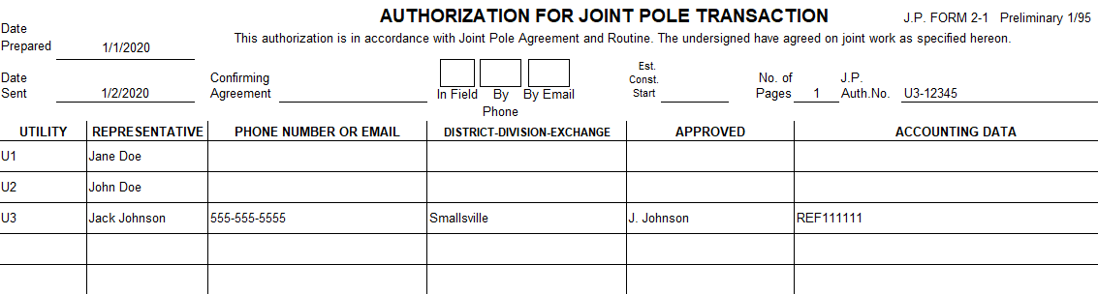
Preliminary Form 2
Form 2 – Examples
Notes:
Presenter Script:
This is an example of a completed header with required information as from the viewpoint of the initiator.
Confirming Agreement date, method, and Est. Const Start date would be completed if available.

Slide 22
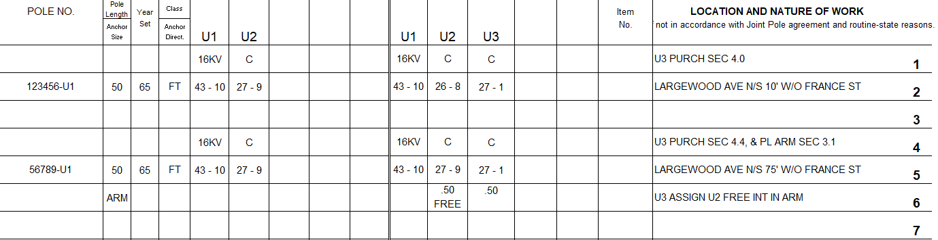
Preliminary Form 2
Form 2 – Examples
Notes:
Presenter Script:
This is an example of U3 purchasing into poles already jointly owned by U1 and U2.
Note the different sections used and appropriate calculations of GR&SP.
Presenter Note:
**For second pole, point out joint construction (Sec 3.1), with added note not to charge U2 for joint ownership of new arm**
**Please refer to Routine Handbook Section 18 for additional examples of various scopes of work, and how they are interpreted on a Form 2 Preliminary**

Slide 23
Preliminary Form 2
Required Documentation – Sec. 18.1a (Pole Load)
Must pass Bending AND Buckling Safety Factor (SF)
(as required and scenario dependent)
Must include ALL existing attachments
Must include ALL proposed attachments
Must represent the finished pole after construction
Applications proposing pole-mounted antenna equipment may require additional documentation/information as mandated by individual committee members.
All Preliminary Form 2 JPA’s must be accompanied with appropriate Pole Loading; with limited exceptions, such as a Correction of Records.
For more comprehensive information on Pole Load requirements, please refer to the Pole Loading Methodology document found within the Technical Resource link at the SCJPC website here: http://scjpc.net/members/technical-resources/.

Slide 24
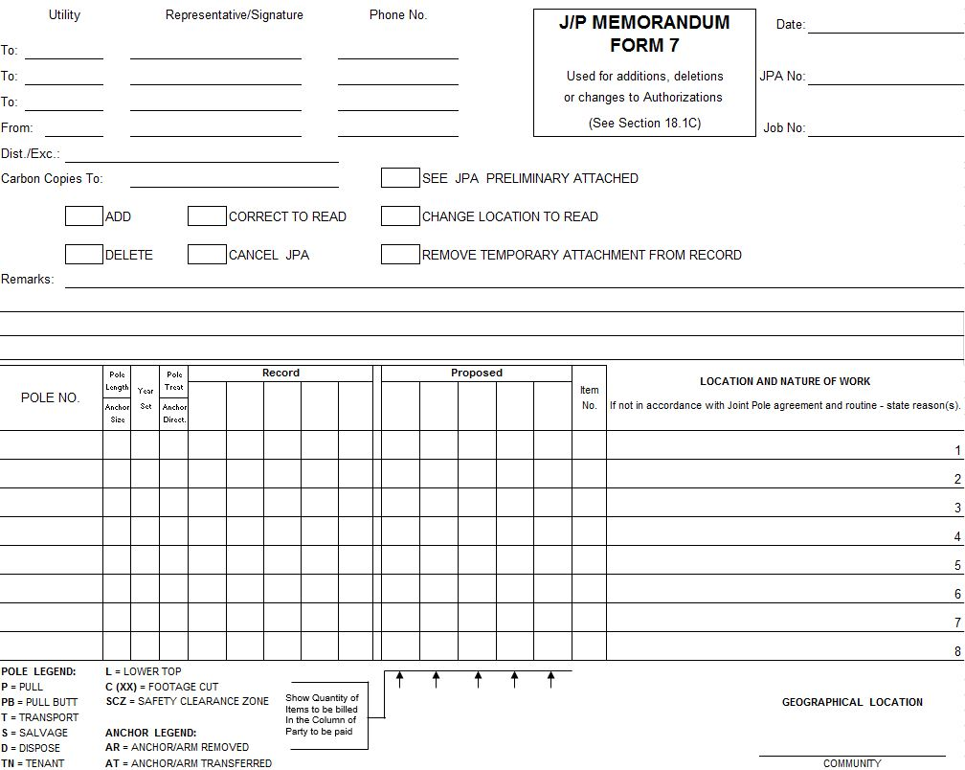
Form 7
Form 7 Overview
Memorandum
  To communicate changes to an initiated Form 2
Typical standard use:
  Address issues with Prelim F2
  Initiate minor changes
Specific guidelines for use
  Refer to Section 18.1c
15-day time limit – from Date Sent

Slide 25
Form 7
Form 7 Basics
Header
Purpose of Form 7.
Check all that apply
“Remarks”
Visual Information of changes (if applicable)
1
2
3
4
Notes:
Presenter Script:
There are four main parts to a Form 7.
Remarks (Part 3) are intended for the initiator to provide details that further clarify the reason of the Form 7.

Slide 26
Form 7
Form 7
Required Information
Date (Sent)
JPA Number
Header
Community
1
3
2
4

Slide 27
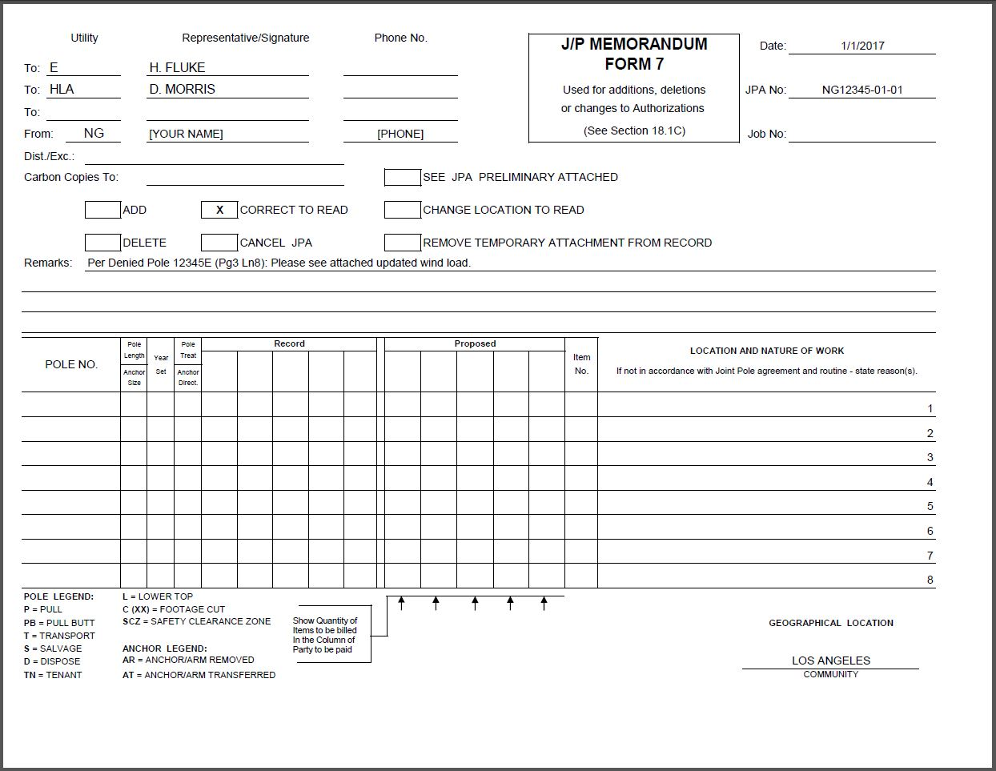
Form 7
Form 7 – Examples
Per Denied Pole 12345E (Pg3 Ln8): Please see attached updated wind load

Slide 28
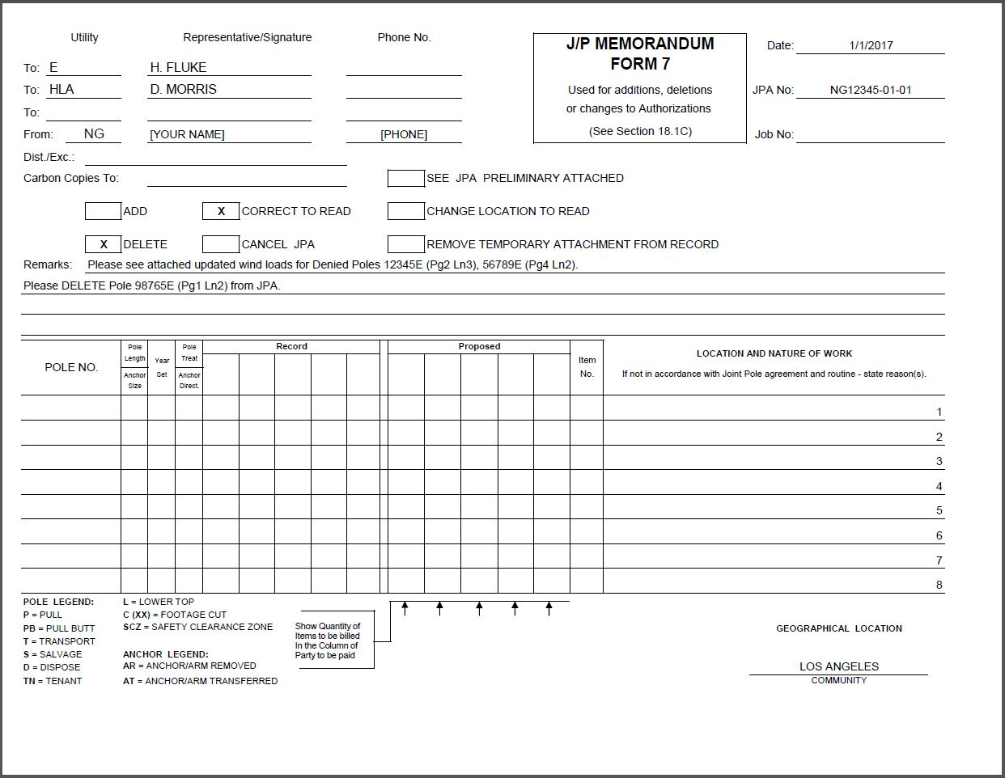
Form 7
Form 7 – Examples
Please see attached updated wind loads for Denied Poles 12345E (Pg2 Ln3) and 56789E (Pg4 Ln2).
Please DELETE Pole 98765E (Pg1 Ln2) from JPA.
Notes:
Presenter Note:
**Please refer to Routine Handbook Section 18 Example 4, for additional Form 7 example.**

Slide 29
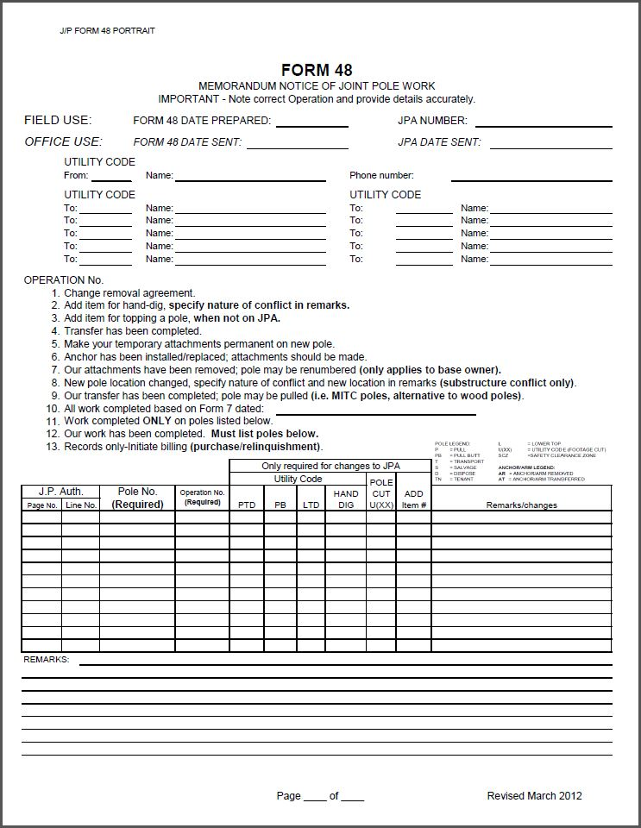
Form 48
Form 48 Overview
Notice of Work Completed
May be used for changes to the pulling routine
45-day time limit – from Date Sent
No construction? No Form 48 required
  Courtesy F48 recommended
  Time limit does not apply
Notes:
Presenter Script:
This Form is utilized to communicate that construction is complete and/or if there were any changes to the pulling routine.
The initiating member may initiate billing after 45 days have elapsed from the date of the Form 48 (Section 18.7).
If no construction is involved with a JPA, a courtesy Form 48 may be initiated. The initiated member does not have to wait 45 days to bill the JPA when no construction was involved.

Slide 30
Form 48
Form 48 Basics
Application Information
Header
Operation Numbers
Pole List
1
2
3
4
Notes:
Presenter Script:
There are four main parts to a Form 48.

Slide 31
Form 48
Form 48
Required Information
Application Information
Header
Pole Numbers / Operation Numbers
1
2
3

Slide 32
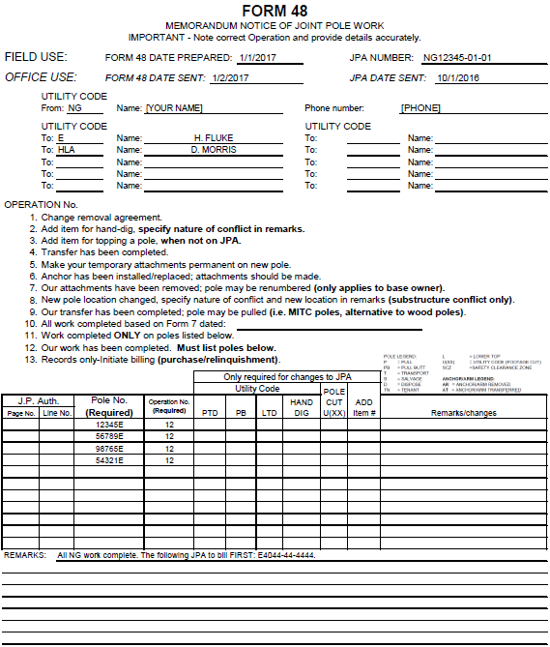
Form 48
Form 48 – Examples (generic all work complete)
Notes:
Presenter Note:
**Point out use of Operation No. 12.**

Slide 33
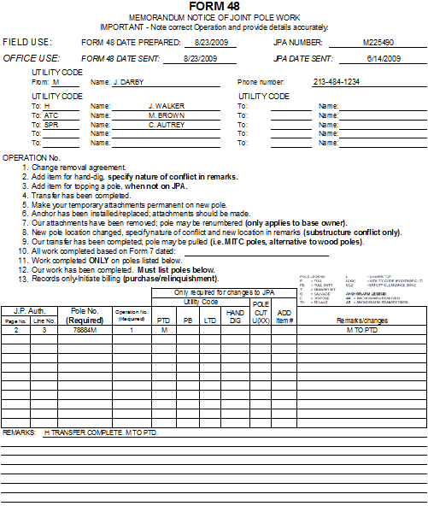
Form 48
Form 48 – Examples (change to pulling routine)
Notes:
Presenter Note:
**Point out use of Operation No. 1 to change the pulling routine as was originally presented on the Form 2.**
**Please refer to Routine Handbook example 20 for additional Form 48 example.**

Slide 34
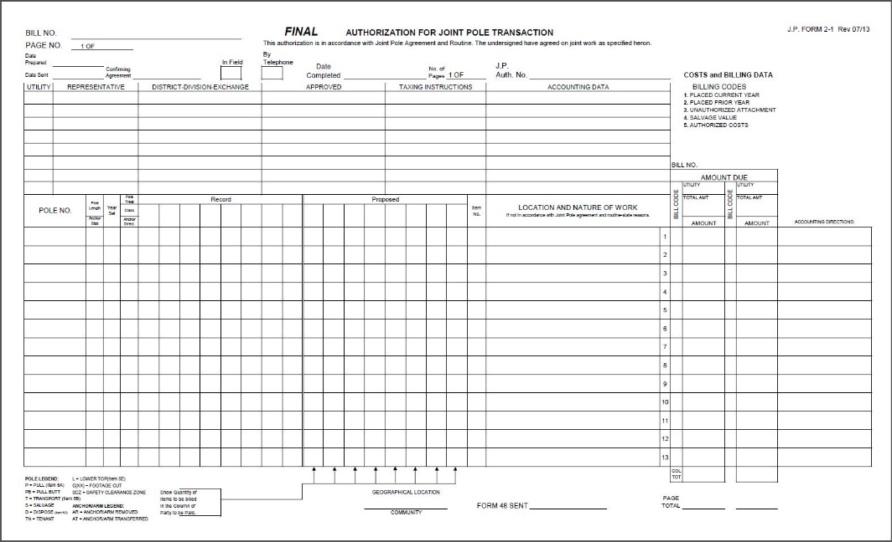
Form 2 FINAL
Form 2 FINAL Overview
Initiates transaction (change to record)
Issued no less than 45-days from Preliminary Form 2
Issued no more than 90-days from Form 48
Must include ALL agreed changes between associated parties
Sent directly to SCJPC for processing
Notes:
Presenter Script:
The Form 2 Final is utilized to initiate billing and establish joint pole records.
At this stage of the life cycle of the JPA, the Form 2 Final should reflect all agreed upon changes from the preliminary.
This form is sent directly to the SCJPC for processing.

Slide 35

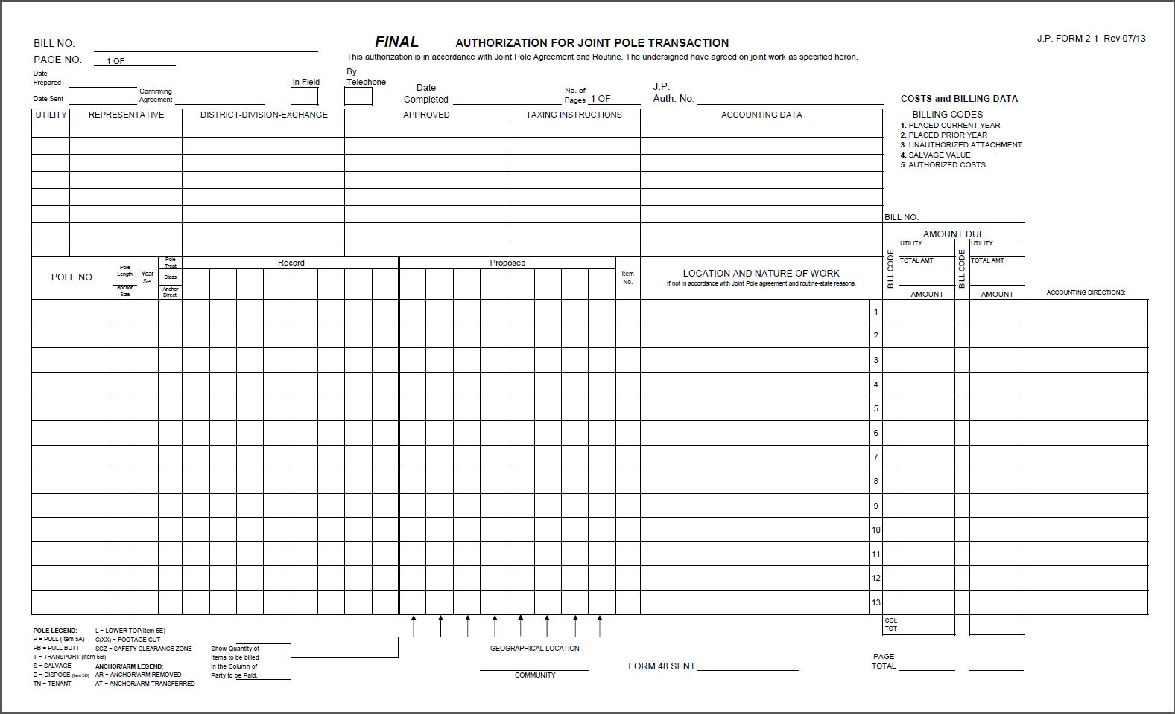
Form 2 FINAL
Form 2 FINAL Basics
Billing Data (to be completed by SCJPC Staff)
Date Sent of Preliminary Form 2
Form 48 Date Sent
Approval(s)
2
4
1
3
Notes:
Presenter Note:
**Elaborate that “Date Sent” is the date the Preliminary was sent to other members, NOT when the Form 2 Final will be sent for billing.**

Slide 36
Form 2 FINAL
Form 2 FINAL – Submission Checklist
Date Sent – Form 48 / Preliminary Form 2
Complete Header / Approvals
All Pole Number(s) confirmed / All Pole Data verified
  No-Tag Poles Identified
  All Year Set/Treatment verified
  Year Set cited for new Anchors
Incorporated all agreed changes between involved parties
GR&SP / Section Numbers make sense and correspond to the SOW
Adequate supporting information (as necessary/required)
Notes:
Presenter Script:
“Supporting Information” (last check) could include notes of adequate clearances when the rules of calculated GR&SP seem contradictory (Routine Example 27).

Slide 37
Other Forms/Unique Processes

Slide 38
Revision
JPA Revision (R01)
Re-submission of a previously initiated JPA
Takes on the original JPA Number, followed by “-R”, and the revision issue number
  e.g. M225490-R01
Automatically cancels the previously [associated] JPA
  e.g. Initiation of M225490-R01 automatically cancels M225490
Classified as a brand new JPA, bound by the rules set forth as such
  Preliminary Form 2 45-day time limit
  New pole loading (as required)
Notes:
Presenter Script:
Typical use of a Revision JPA include:
Addressing an issue that cannot be resolved by the limited capabilities of a Form 7
REV and R1 are also acceptable notations for a Revision.
If further revisions are required, the next sequence number will be used for every revision issued – R01, then R02, then R03, etc.. Each subsequent revision will cancel the prior revision issued.

Slide 39
Supplementary
JPA Supplementary (S01)
A JPA that is related to a previously initiated JPA that is currently pending
Takes on the original JPA Number, followed by “-S”, and the supplementary issue number
  e.g. M225490-S01
Classified as a brand new JPA, bound by the rules set forth as such
  Preliminary Form 2 45-day time limit
  New pole loading (as required)
Notes:
Presenter Script:
Typical use of a Supplementary JPA include:
Initiation of a new JPA, for poles related in some way to the poles issued on a previously initiated JPA
Initiation of a new JPA, for poles removed from a previously initiated JPA, but may still require a JPA to be issued
Unlike a Revision, a Supplementary JPA does not cancel any previously initiated JPA.

Slide 40
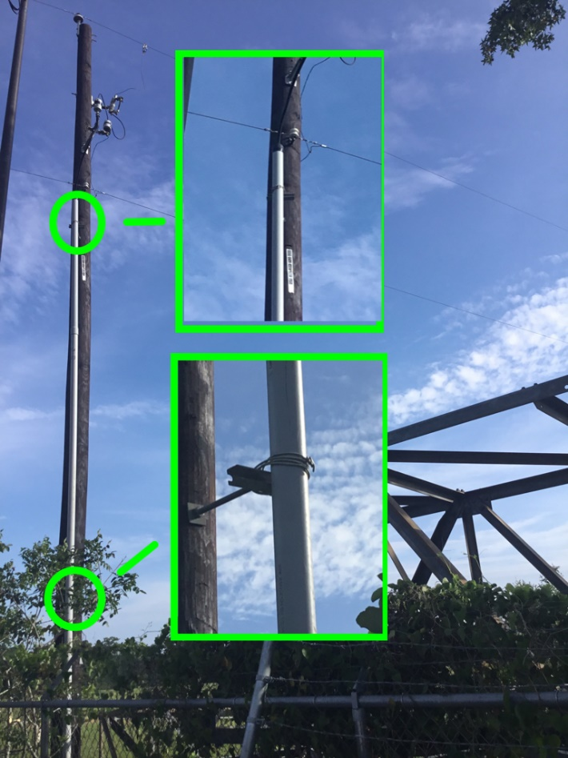
Riser Application
Form 9
When no Form 2 Preliminary is required
Notice of proposed riser placement on pole(s)
15-day time limit – from Date Sent

Slide 41
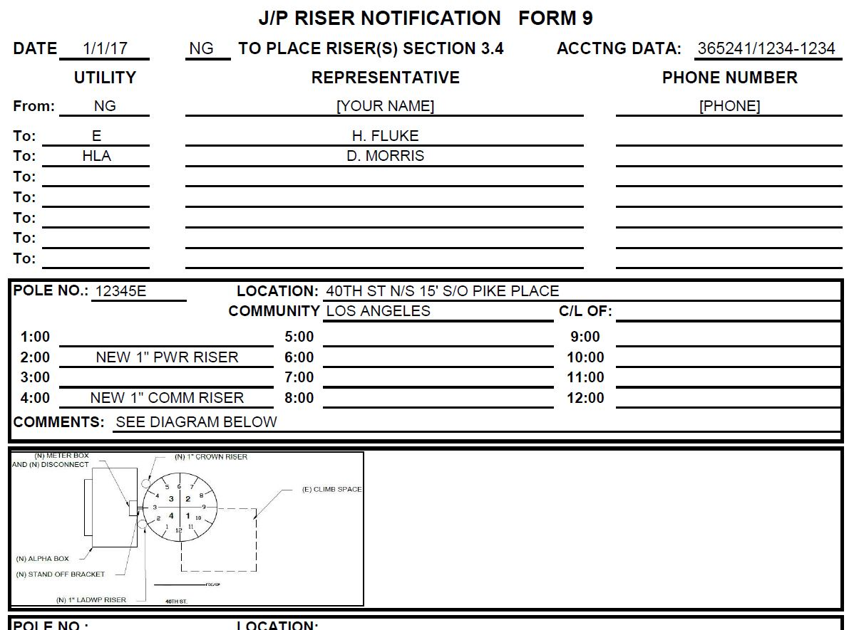
Riser Application
Form 9 – Example
Notes:
Presenter Note:
**Point out detail of size and placement of risers.**
**Point out riser diagram (manually) embedded on Form 9 (Excel). Riser diagram may also be added as a separate attachment**
**Please refer to Routine Handbook Section 18 Example 10 for additional Form 9 example.**

Slide 42
Responses
Form 2 / Form 7
A response to a JPA Form from a receiving member
May be categorized as one of the following:
  Approved
  Approved with Changes (redlines)
  Denied.
Responses may require additional actions between the initiator and receiving members. E.g. Revised Form 2, Form 7, etc.

Slide 43
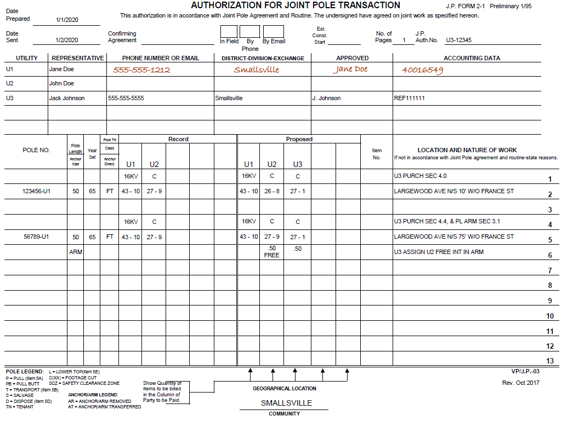
Responses
Form 2 Response – Example (Approved)
Notes:
Presenter Script:
This is an example of an approval received from U1.
Presenter Note:
**Point out U1 completed U1 header information in response**

Slide 44
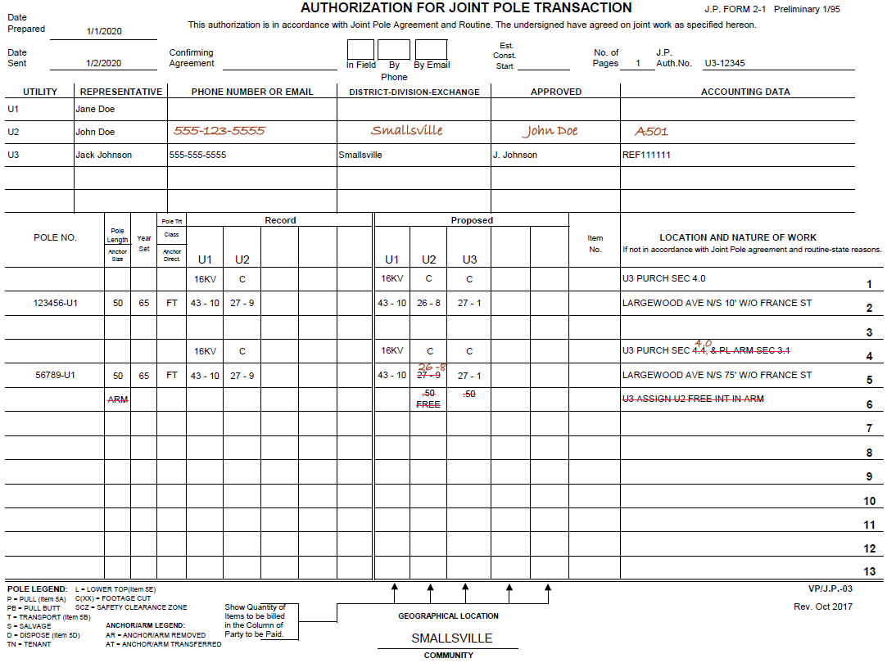
Responses
Form 2 Response – Example (Approved with Change)
Notes:
Presenter Script:
This is an example of an approval with redlined changed from U2.
Presenter Note:
**Point out U2 completed U1 header information in response.**
**Point out U2 changes to GR&SP, Section #, and Arm information.**

Slide 45
Returned FINAL Form 2
SCJPC Memo
Returned Form 2 FINAL (from committee staff), which cannot be processed for billing
Includes cover sheet with description of discrepancies that are preventing the billing process
May include ‘sticky’ notes throughout the returned Form 2 Final with additional details
All original documents (cover sheet, sticky notes) are sent back (hard copy) to the committee staff for billing once all discrepancies are addressed

Slide 46
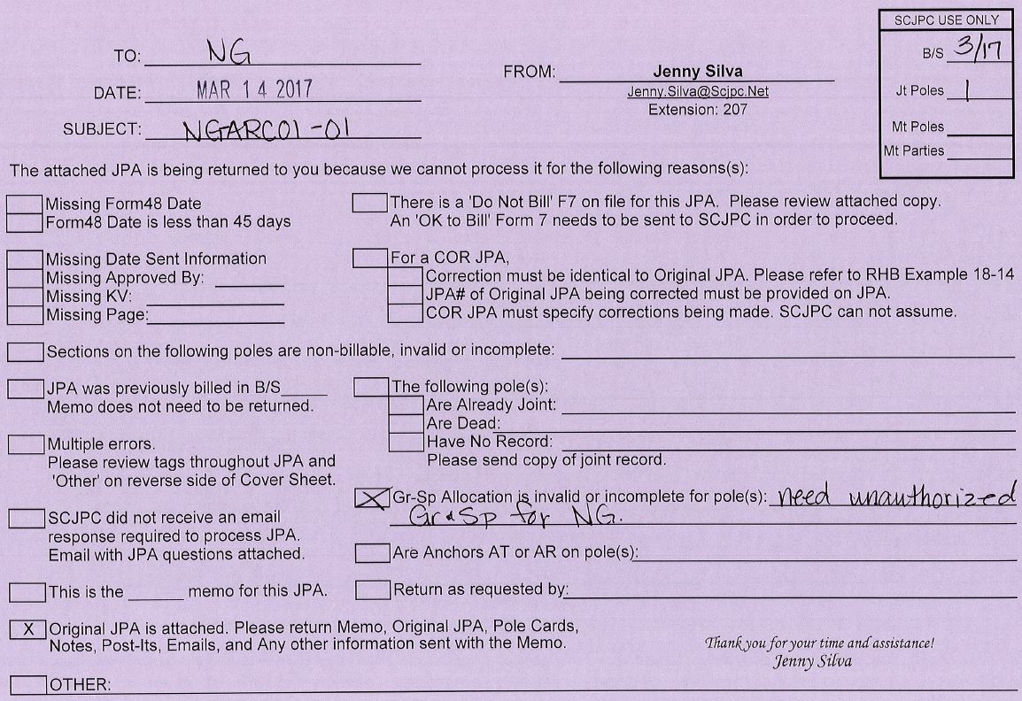
Returned FINAL Form 2
SCJPC Memo – Example
Notes:
Presenter Note:
**Point out explanation noted, preventing the billing of the JPA**

Slide 47
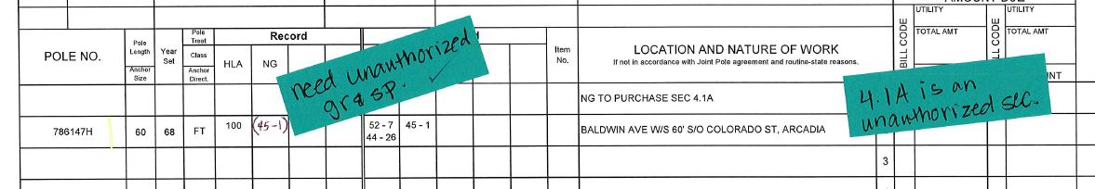
Returned FINAL Form 2
SCJPC Memo – Example
Notes:
Presenter Note:
**Point out ‘sticky’ notes with further details, as found within the attached Form 2 Final.**
**Point out ‘check mark’ on note, confirming that issue has been addressed. In this case, the UA GR&SP has been manually written in.**

Slide 48
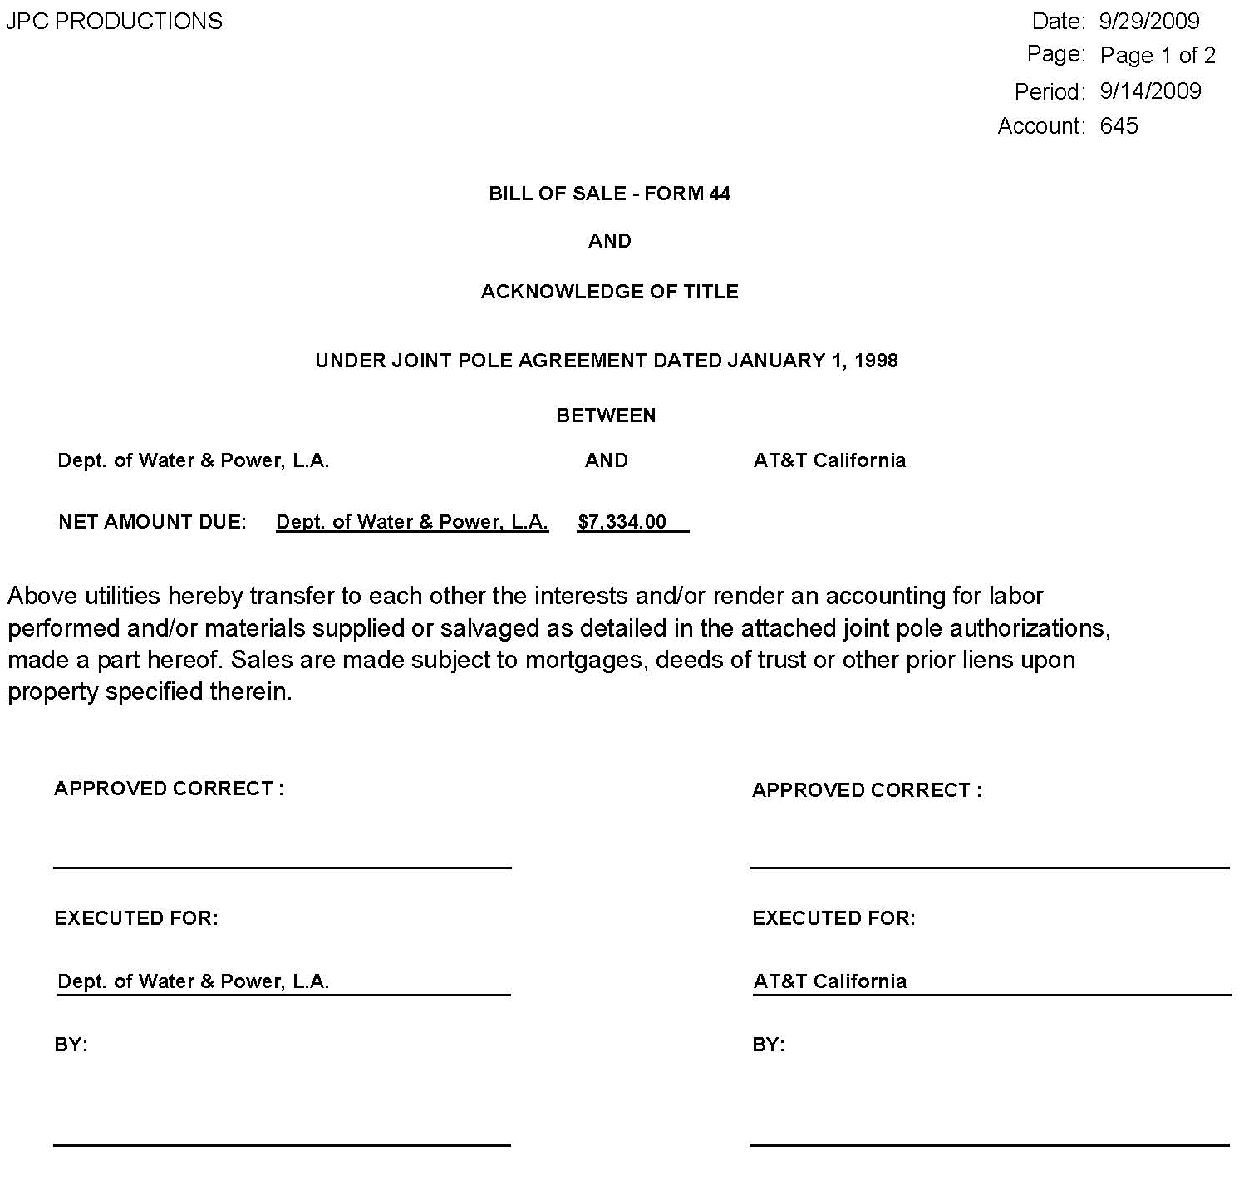
Form 44
Bill of Sale
Members receive this Form from the SCJPC office reflecting monthly activity.
This Form is authorization for each member to invoice for the monthly activity.

Slide 49
Form 44
Bill of Sale – Example (Pg.1)

Slide 50
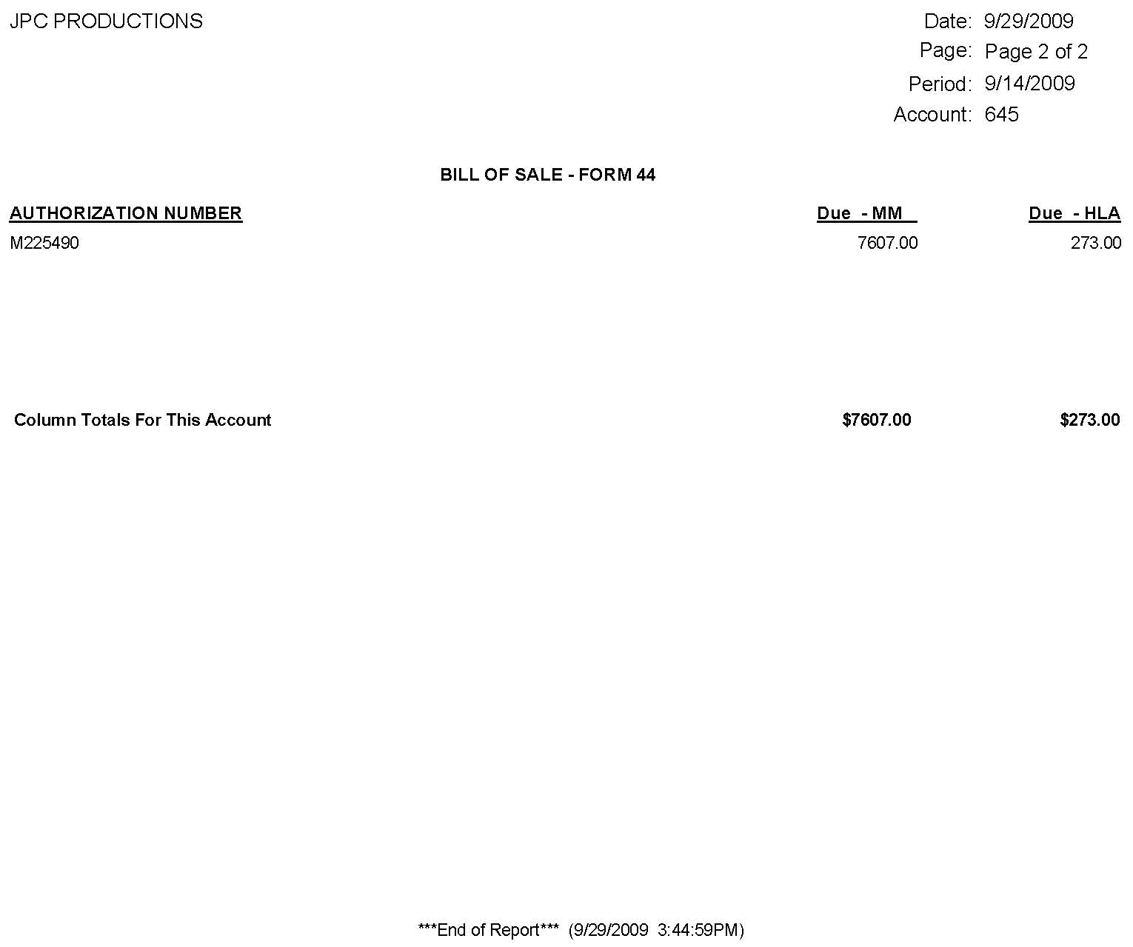
Form 44
Bill of Sale – Example (Pg. 2)

Slide 51
Questions?

