Slide 1
18.1G
Billing out of Sequence (BOS)

Slide 2


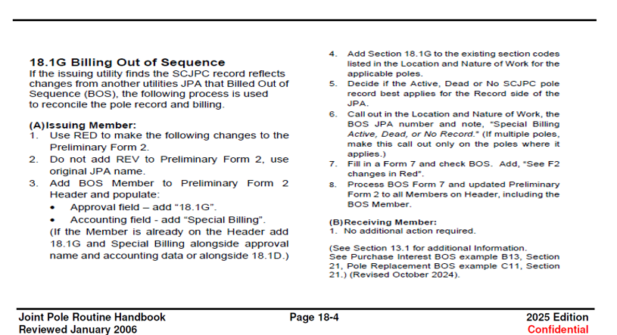
18.1G was added to the routine Handbook in 2024. This was an alternative to correction of record JPAs resulting from members billing their JPAs out of sequence.
18.1G reads: If the issuing utility finds the SCJPC record reflects changes from another utilities JPA that Billed Out of Sequence (BOS), the following process is used to reconcile the pole record and billing.

Slide 3

Preliminary Setup

Slide 4
(A) Issuing Member”
Use RED to make changes to the Preliminary Form 2.
Do NOT add REV to Preliminary Form 2, use original JPA name.
Add BOS Member to Preliminary Form 2 Header and populate.
Add Section 18.1G to the existing section codes listed in the Location and Nature of Work for the applicable poles.
Decide if the Active, Dead or No SCJPC pole record best applies for the Record side of the JPA.
Call out in the Location and Nature of Work, the BOS JPA number and note, “Special Billing Active, Dead, or No Record.” (If multiple poles, make this call out only on the poles where it applies.)
Fill in a Form 7 and check BOS. Add, “See F2 changes in Red”.
Process BOS Form 7 and updated Preliminary Form 2 to all Members on Header, including the BOS Member.

Slide 5
1. USE RED TO MAKE THE FOLLOWING CHANGES TO THE Preliminary FORM2:

Slide 6

2. DO NOT ADD REV TO Preliminary FORM 2, USE ORIGINAL JPA NAME

Slide 7
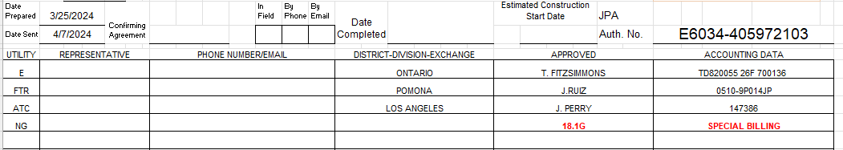
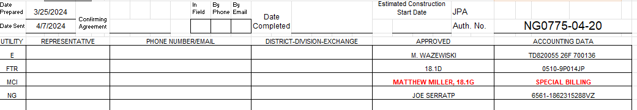
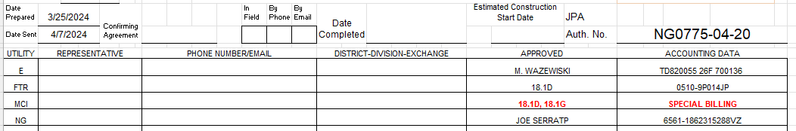
3. ADD BOS MEMBER TO Preliminary FORM 2 HEADER AND POPULATE​
Approval field – add “18.1G”
Accounting field – add “Special Billing”
(If the Member is already on the Header add 18.1G and Special Billing alongside approval name and accounting data or alongside 18.1D)

Slide 8


4. ADD SECTION 18.1G TO THE EXISTING SECTION CODES LISTED IN THE Location AND NATURE OF WORK FOR THE APPLICABLE POLES.

Slide 9
5. Decide if the ACTIVE, dead, or no scjpc pole record applies for the record side of the jpa.
Determine the changes made to SCJPC record and how it effects your JPA.
This will determine which SCJPC record you will want to use (Active, Dead, or No Record)
ACTIVE – When using the ACTIVE record, the pole card is the correct pole information just adding the BOS member. The BOS member would be added to the record side. The quantities would include the BOS member. Unlike a RO1, the Date Sent should not be changed.
DEAD – When using the DEAD record, the pole card pole information is the updated or new pole and there is a “missing” replacement that needs to bill. The BOS member would be added to only the proposed side. The quantities would not include the BOS member. The Date Sent should not be changed.
NO RECORD - No Record is when the BOS member established a joint record on the newer pole, bypassing a pending replacement.

Slide 10
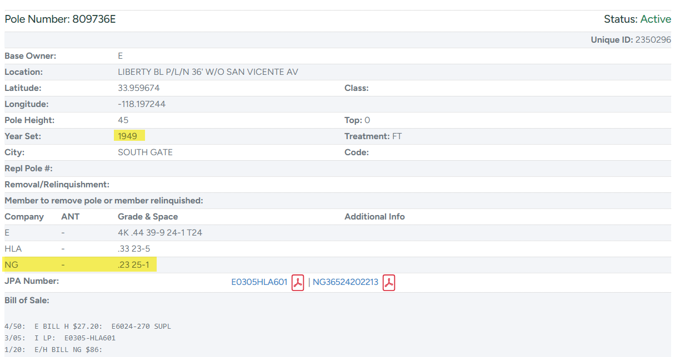
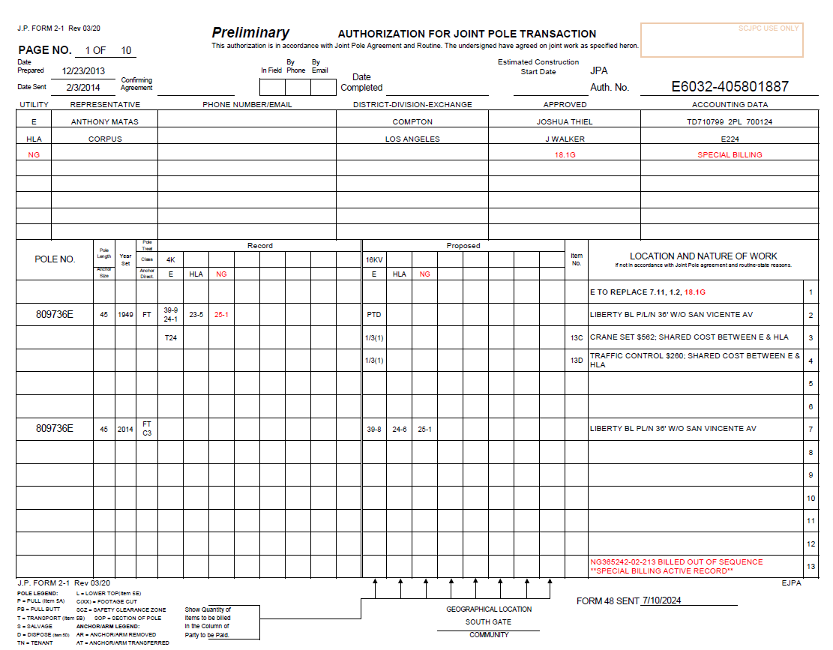
ACTIVE RECORD: When using the ACTIVE record, the pole card is the correct pole information just adding the BOS member. The BOS member would be added to the record side. The Quantities would include the BOS member. Unlike a RO1, the Date sent should not be changed.

Slide 11
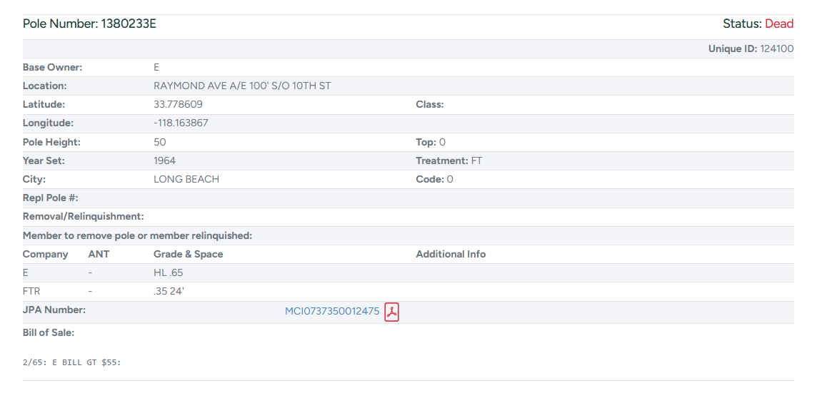
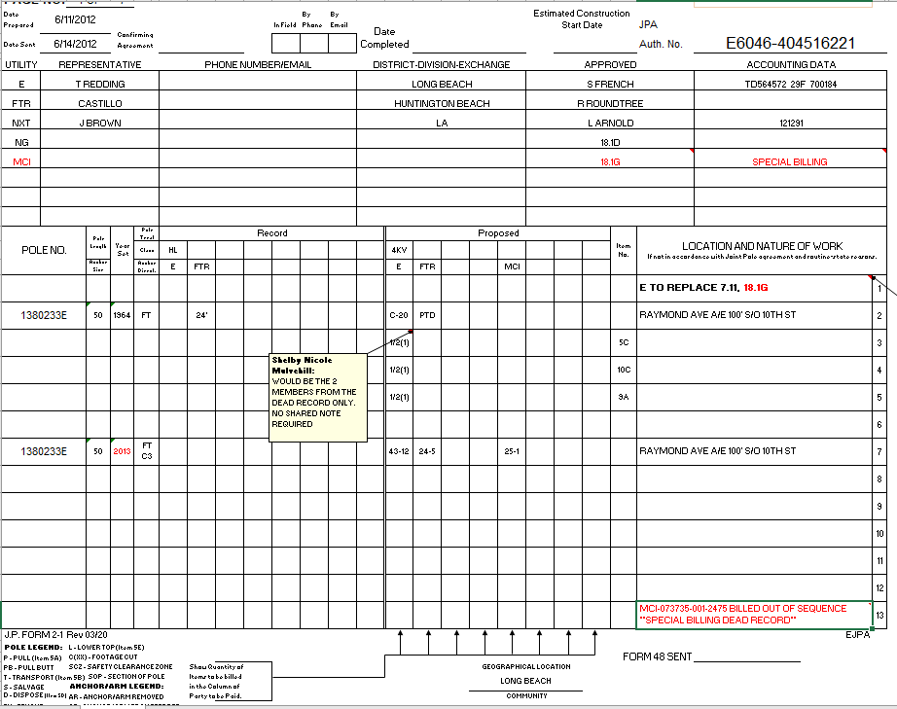
Dead Record When using the DEAD record, the pole card pole information is the updated or new pole and there is a “missing” replacement that needs to bill. The BOS member would be added to only the proposed side. The Quantities would not include the BOS member. The Date sent should not be changed.

Slide 12
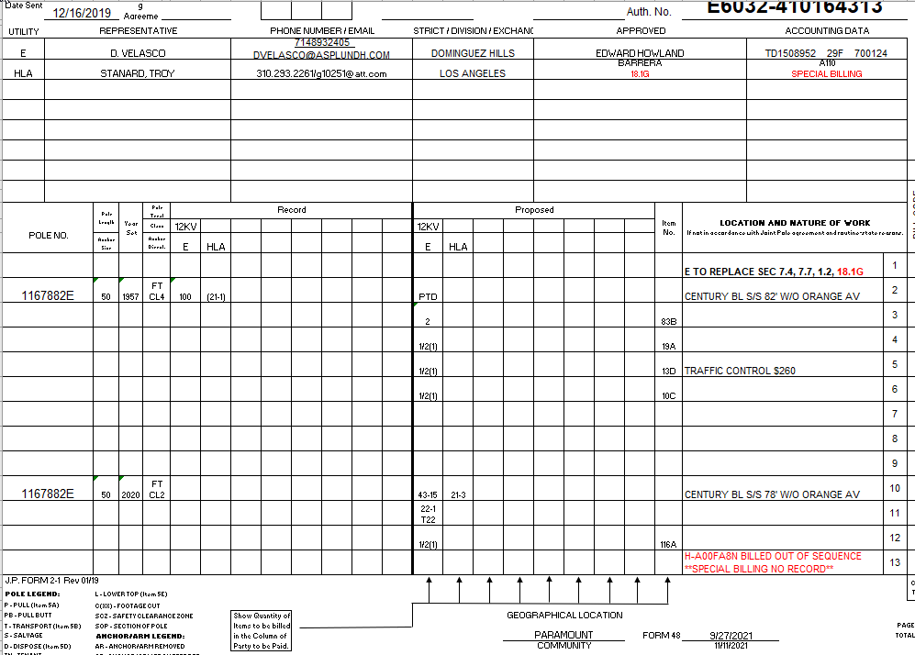
No Record - No Record special billing is when the BOS member established a joint record on the newer pole, bypassing a pending replacement.

Slide 13
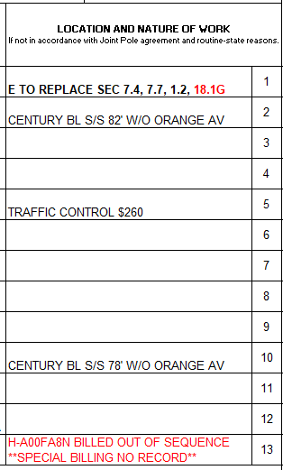
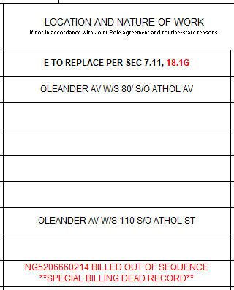
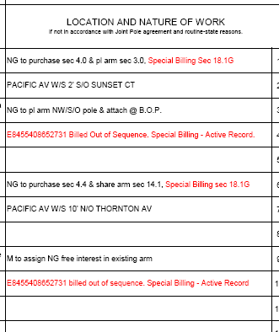
6. CALL OUT IN THE LOCATION AND NATURE OF WORK, THE BOS JPA NUMBER AND NOTE “SPECIAL BILLING Active, dead, or no record.” (if multiple poles, make this call out only on the poles where it applies.)

Slide 14
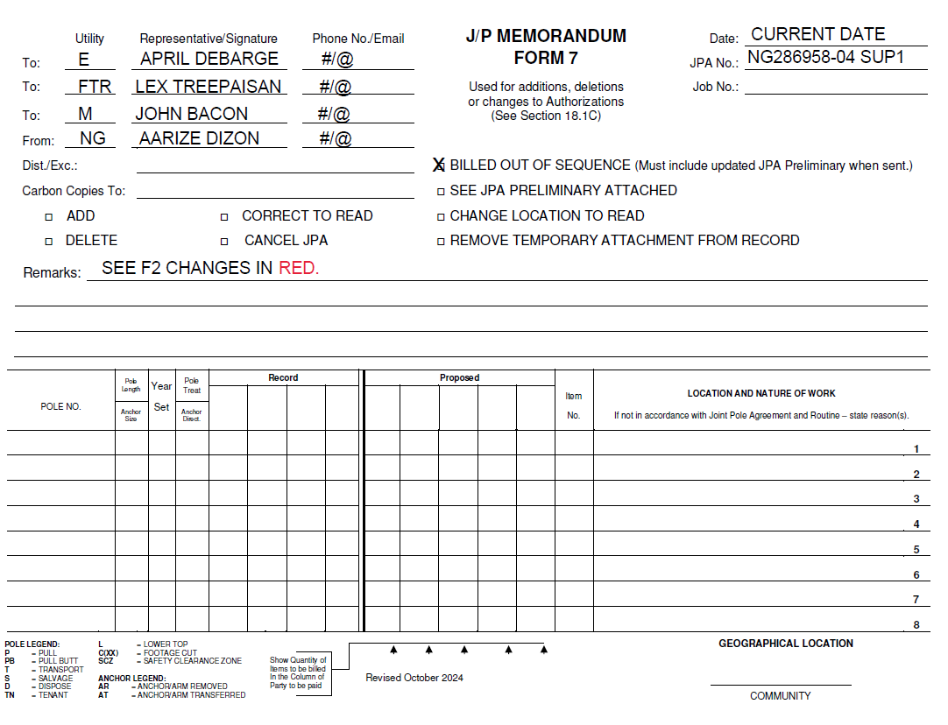
7. Fill in a form 7 and check bos. Add, “see f2 changes in red”

Slide 15
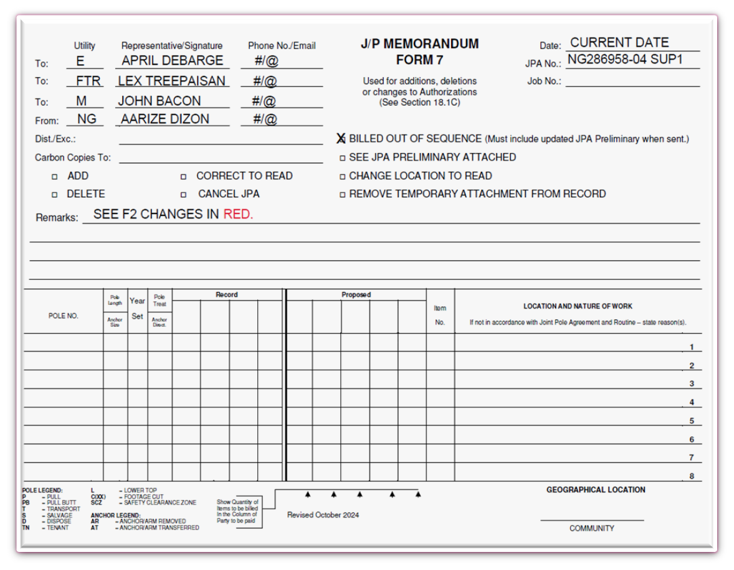
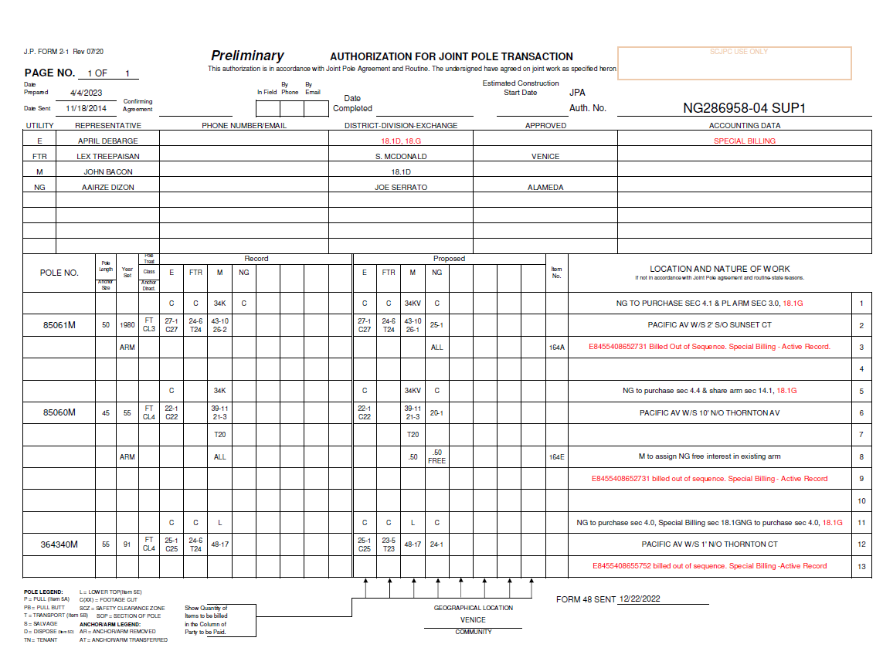
8. Process bos form 7 and updated preliminary form 2 to all members on header, including the bos member.

Slide 16
(B) Receiving Member
1. No additional action required.

