Slide 1
18.1G
Billing out of Sequence (BOS)
Preliminary Setup
(Replacement - DEAD RECORD)

Slide 2


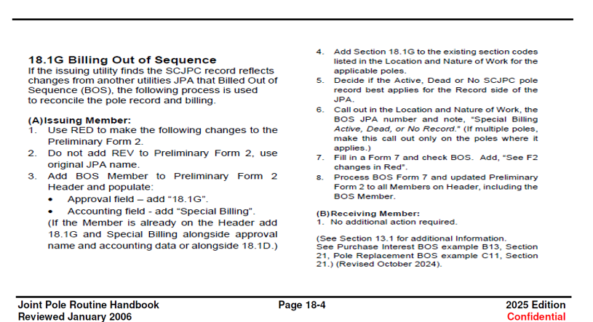
18.1G was added to the routine Handbook in 2024. This was an alternative to correction of record JPAs resulting from members billing their JPAs out of sequence.
18.1G reads: If the issuing utility finds the SCJPC record reflects changes from another utilities JPA that Billed Out of Sequence (BOS), the following process is used to reconcile the pole record and billing.

Slide 3

Preliminary Setup
(Replacement – DEAD RECORD)

Slide 4
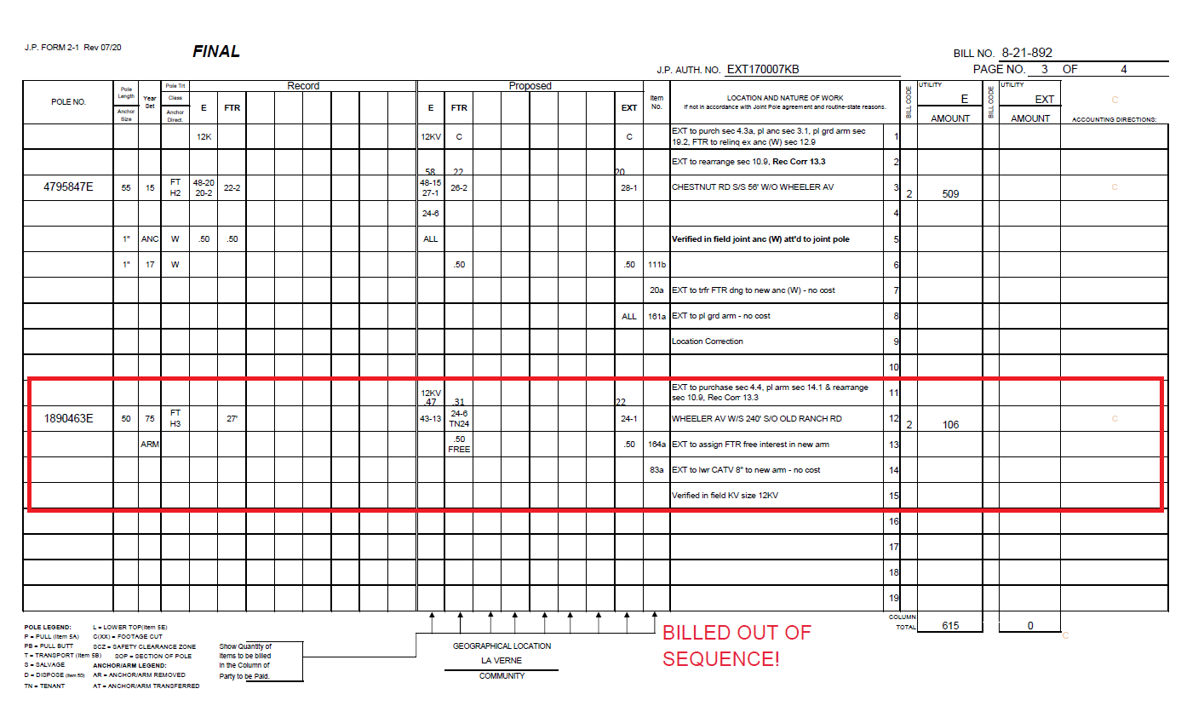
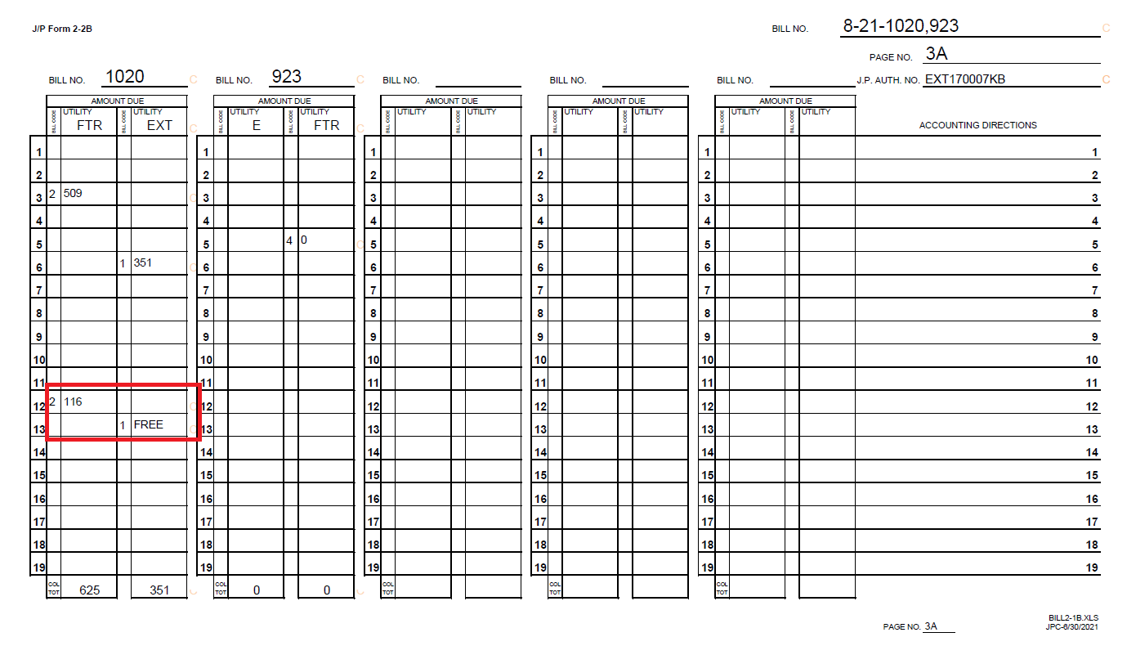
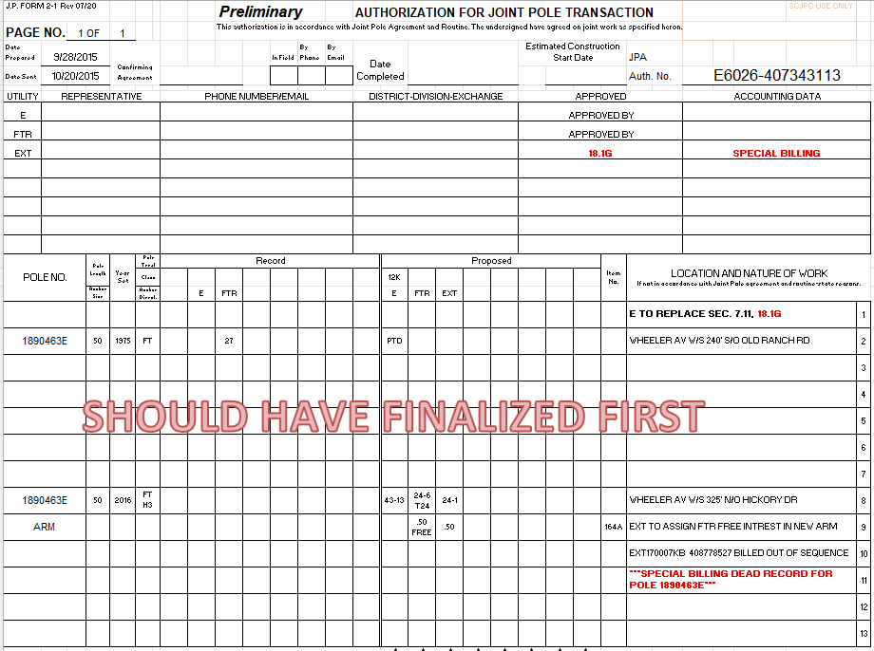
History: EXT17007KB billed out of sequence. E6026-407343113 should have FINALIZED first.
On EXT17007KB pole 1890463E shows EXT to purchase interest at 24-1 and placing a new arm.
For JPA E6026-407343113, the replacement of pole 1890463E (year set 1975) with pole 1890463E (year set 2016) should have been finalized first establishing an E and FTR NEW JOINT pole. EXT should have purchased interest on the existing 2016 pole.

Slide 5
Preparing the preliminary for billing

Slide 6
(A) Issuing Member:
Use RED to make changes to the Preliminary Form 2.
Do NOT add REV to Preliminary Form 2, use original JPA name.
Add BOS Member to Preliminary Form 2 Header and populate.
Add Section 18.1G to the existing section codes listed in the Location and Nature of Work for the applicable poles.
Decide if the Active, Dead or No SCJPC pole record best applies for the Record side of the JPA.
Call out in the Location and Nature of Work, the BOS JPA number and note, “Special Billing Active, Dead, or No Record.” (If multiple poles, make this call out only on the poles where it applies.)
Fill in a Form 7 and check BOS. Add, “See F2 changes in Red”.
Process BOS Form 7 and updated Preliminary Form 2 to all Members on Header, including the BOS Member.

Slide 7
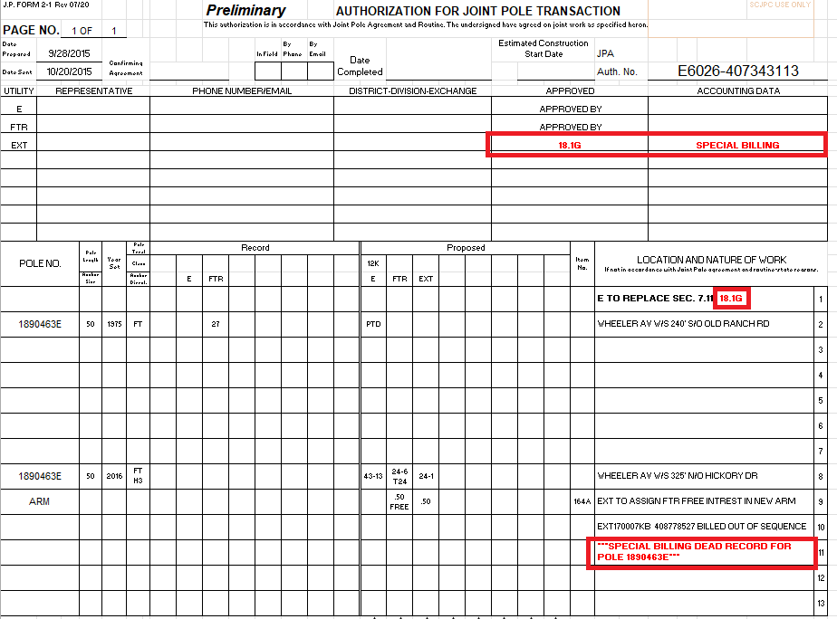
1. USE RED TO MAKE THE FOLLOWING CHANGES TO THE PRELIMINARY FORM2:

Slide 8

2. DO NOT ADD REV TO PRELIMNARY FORM 2, USE ORIGINAL JPA NAME

Slide 9
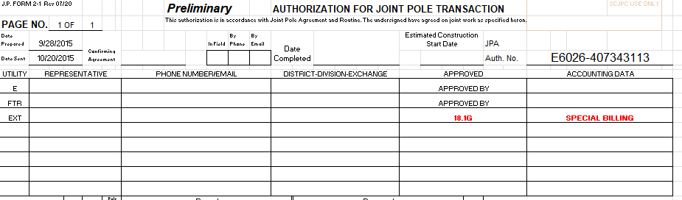
3. ADD BOS MEMBER TO PRELIMNARY FORM 2 HEADER AND POPULATE​
Approval field – add “18.1G”
Accounting field – add “Special Billing”

Slide 10

4. ADD SECTION 18.1G TO THE EXISTING SECTION CODES LISTED IN THE LOCTION AND NATURE OF WORK FOR THE APPLICABLE POLES.

Slide 11
5. Decide if the ACTIVE, dead, or no scjpc pole record applies for the record side of the jpa.
Determine the changes made to SCJPC record and how it effects your JPA.
This will determine which SCJPC record you will want to use (Active, Dead, or No Record)

Slide 12
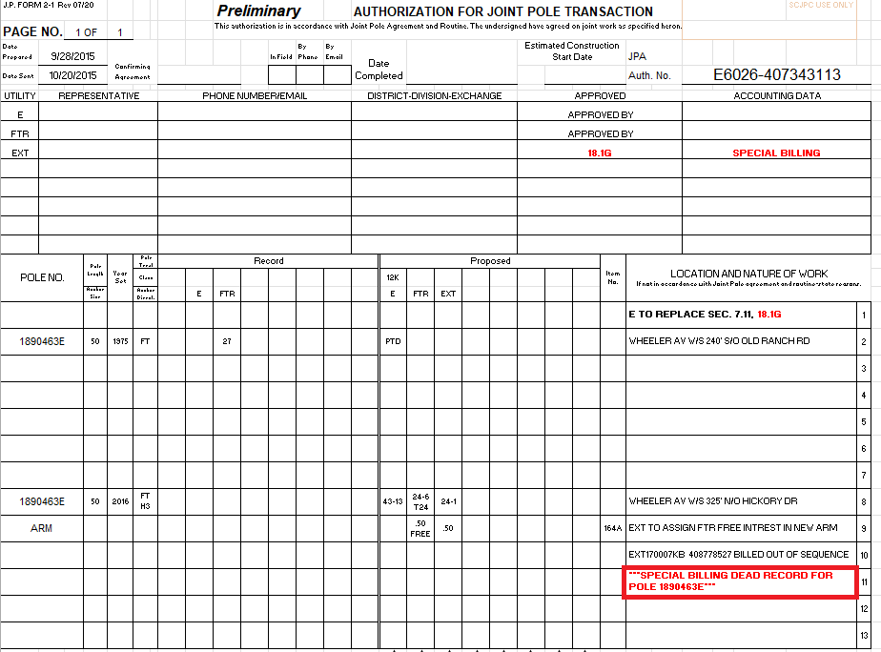
For JPA e6026-407343113, 'DEAD RECORD' should be noted, as the replacement occurred prior to EXT’s PURCHASE of interest.
Dead Record - Use the dead record when the pole card is missing a replacement that needed to bill first.
. The BOS member would be added to only the proposed side. The Quantities would not include the BOS member. The Date sent should not be changed.
.

Slide 13
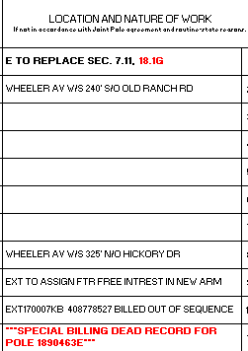
6. CALL OUT IN THE LOCATION AND NATURE OF WORK, THE BOS JPA NUMBER AND NOTE “SPECIAL BILLING DEAD record”.

Slide 14
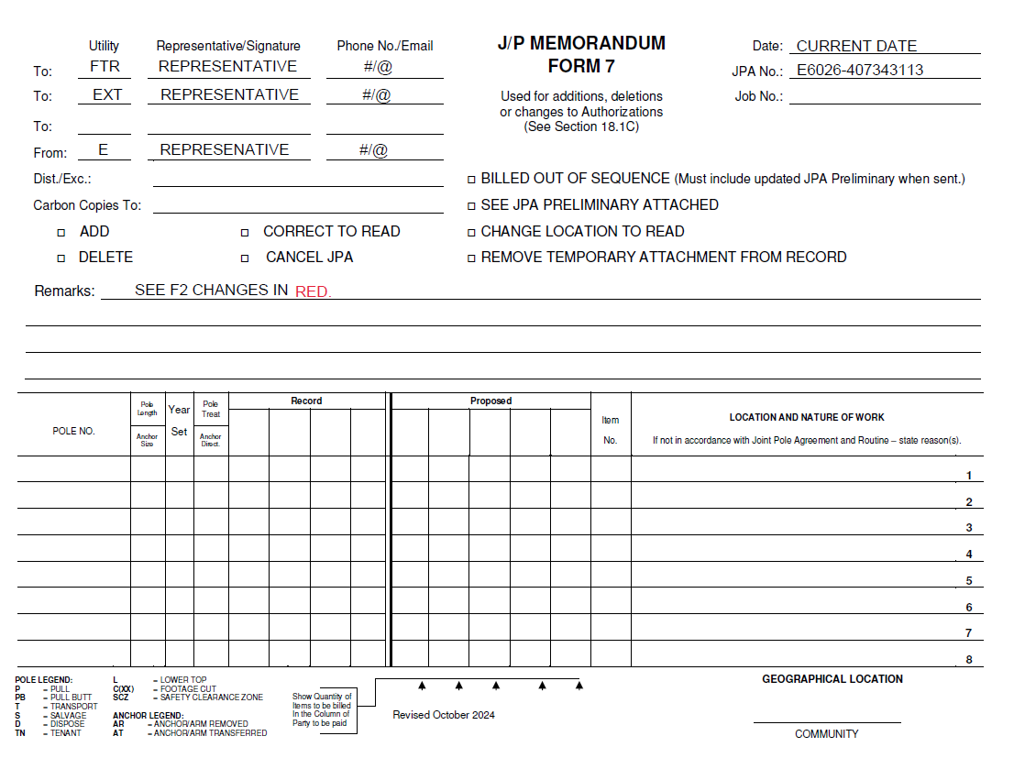
7. Fill in a form 7 and check bos. Add, “see f2 changes in red”

Slide 15
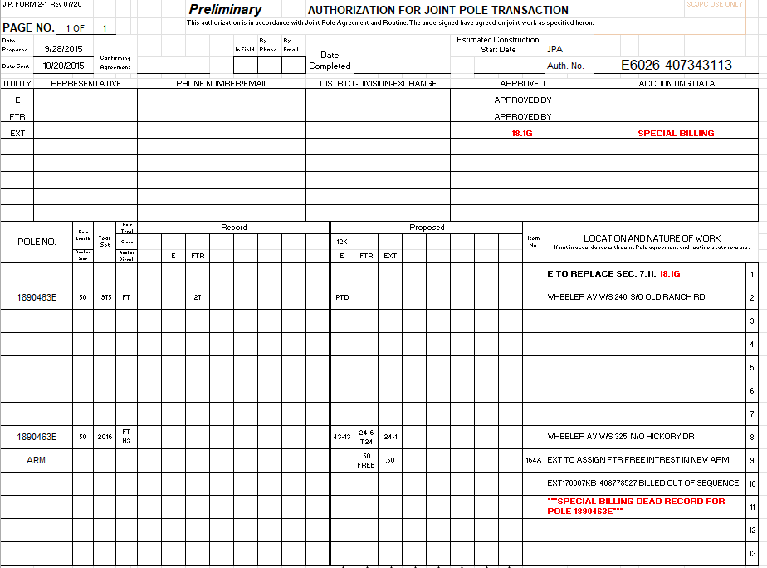
8. Process bos form 7 and updated preliminary form 2 to all members on header, including the bos member.

Slide 16
(B) Receiving Member
1. No additional action required.

